Slide 1
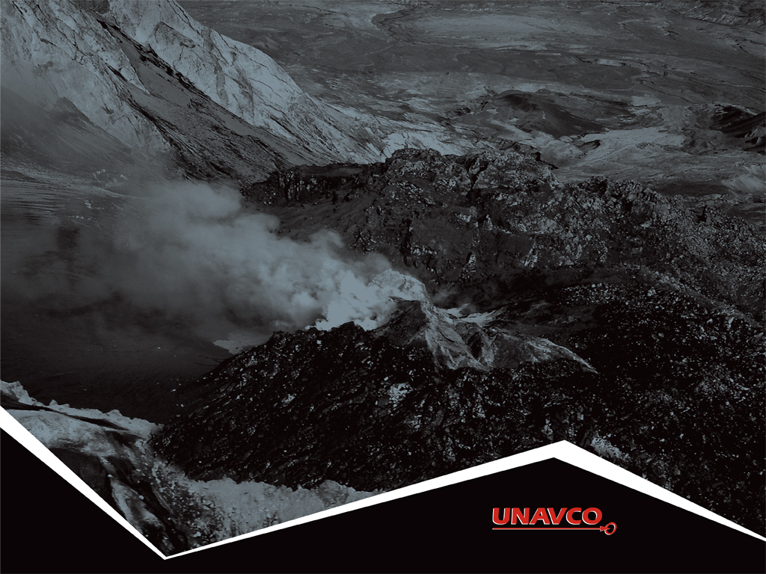
Reading GPS
Time Series Plots: Using GPS to study tectonic plates move, twist, and crumple
Roger Groom and Cate Fox-Lent, UNAVCO Master Teachers-in-Residence, and Shelley Olds, UNAVCO

Slide 2
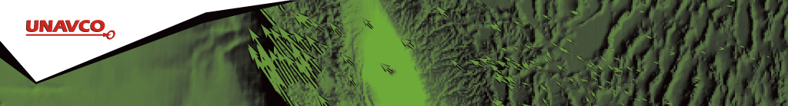
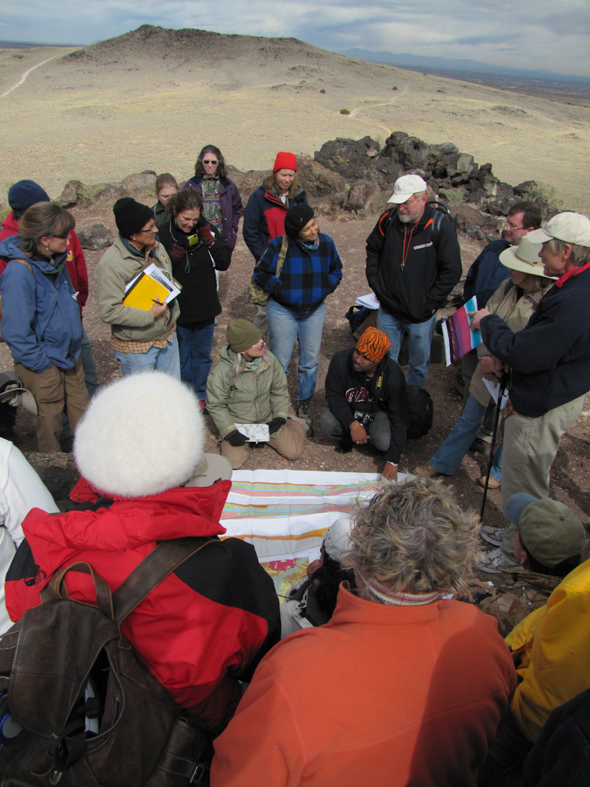
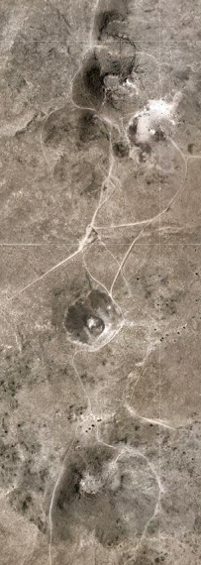
Geologic Temporal & Spatial scales are very Large
Notes:
From south to north the volcanoes west of Albuquerque : AJ, Black, and Vulcan
Earth's tectonic plates are constantly moving, grinding, and crumpling in an inexorably slow but measurable, dance.
The temporal and spatial scales of plate tectonics and other Earth processes can be difficult to understand for many learners.
Many volcanoes take thousands of years to form, others can grow overnight.
the cinder cone volcano Paricutin appeared in a Mexican cornfield on February 20, 1943

Slide 3
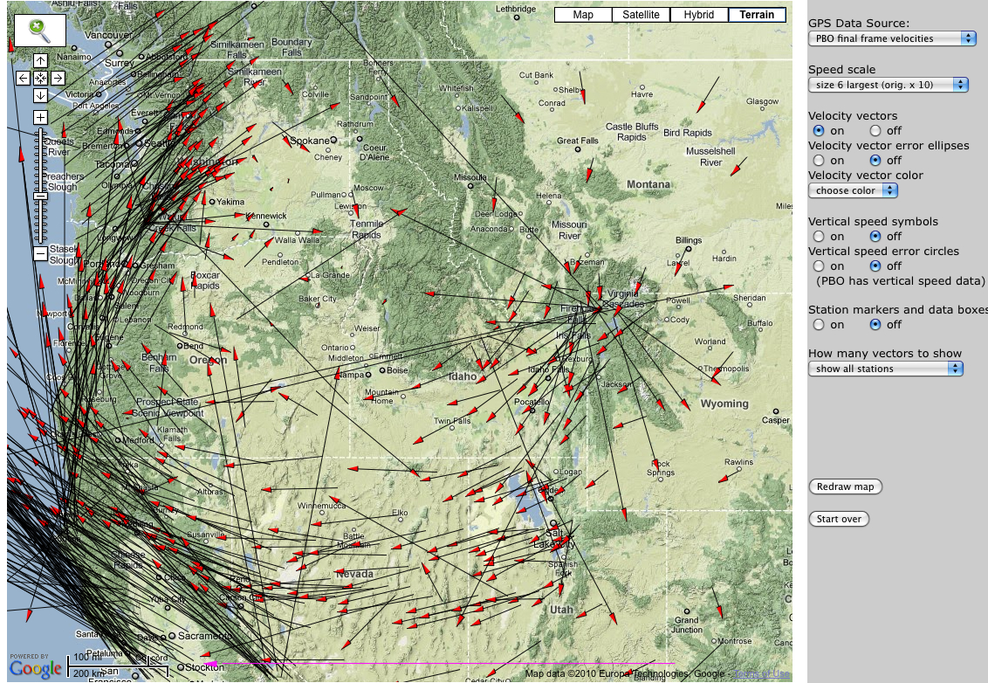
GPS brings plate tectonics to the human scale of millimeters per year
25 mm/yr
Data Source: UNAVCO Plate Boundary Observatory: North American Reference Frame
UNAVCO GPS Velocity Viewer: http://geon.unavco.org/unavco/GEV.php
Notes:
Explain again what the vector arrows mean and walk through the map to point out interesting areas.
Explain reference frame …
It is the visual display of GPS, LiDAR, InSAR data, however, that helps make plate tectonics come alive for learners as a process that is happening in the present.

Slide 4
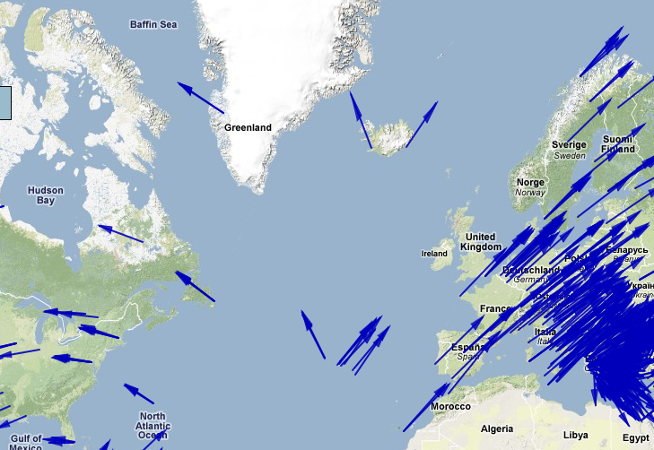
With GPS, Learners can see the plates moving apart
Data source: Global Strain Rate Map Project ; Reference Frame: No Net Rotation
UNAVCO GPS Velocity Viewer: http://geon.unavco.org/unavco/GEV.php
Notes:
It is the visual display of GPS, LiDAR, InSAR data, however, that helps make plate tectonics come alive for learners as a process that is happening in the present.
Scale – approx 20 mm/yr for vectors in Iceland
Reference Frame: No Net Rotation – using the velocity viewer

Slide 5
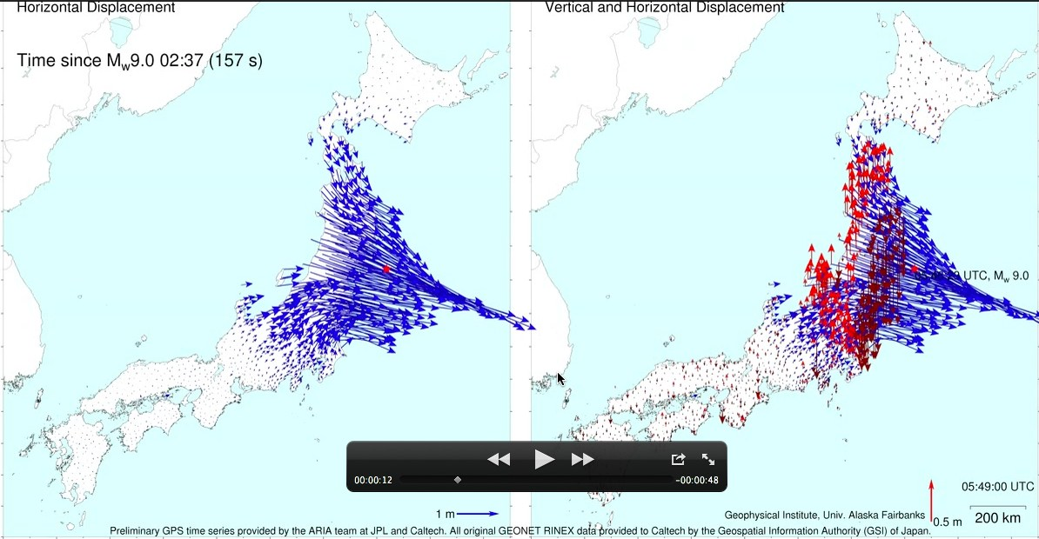
With GPS, You can SEE the Land Move!
Mw=9.0 Tohoku, Japan Earthquake
Credit: Grapenthin, Freymueller (University of Alaska Fairbanks), ARIA project (JPL/Caltech)
Sendai 2011-Mar-11, 05:46:23 UTC Earthquake: Each dot/arrow represents a continuous high precision GPS station of which more than 1200 are distributed throughout Japan in a network called GEONET.
If the ground moves (from an earthquake) then the GPS moves and records this movement.
Notes:
Kinematic GPS solutions
http://gps.alaska.edu/ronni/download/Grapenthin_Freymueller_2011_earthscope_poster.pdf
Permanent displacements after the Mw 9.0 earthquake: blue is horizontal, red is vertical.
Vertical displacements are almost all subsidence, which means that all slip-induced uplift occurred off-shore.
rupture took about 180 s

Slide 6
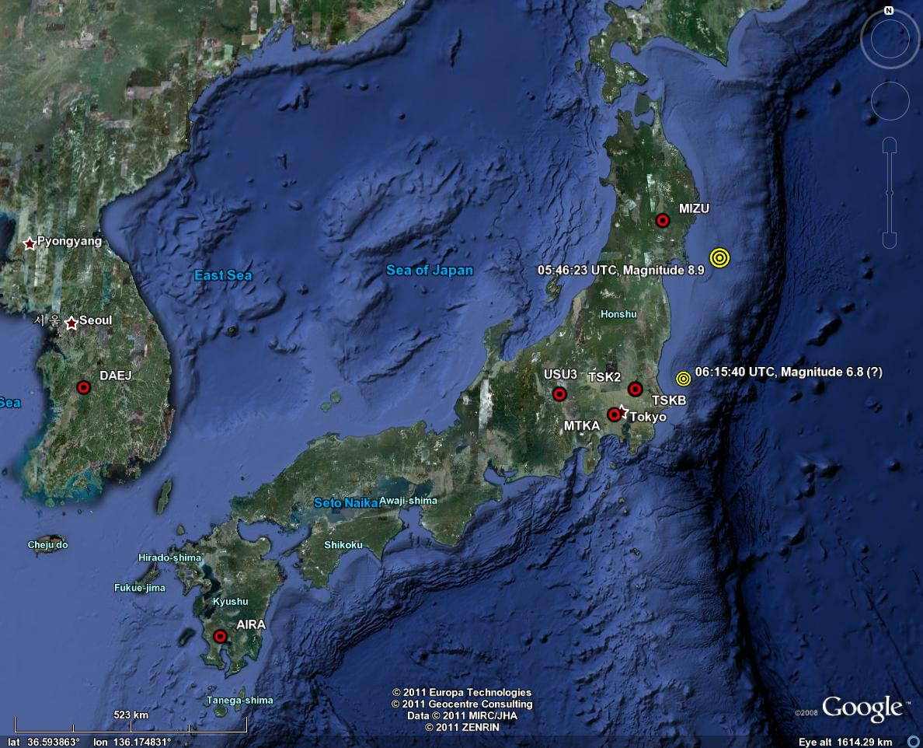
Sendai 2011-Mar-11, 05:46:23 UTC Earthquake
Notes:
Other resources and presentations about this earthquake:
http://www.iris.edu/news/events/japan2011/
http://www.iris.edu/hq/retm
Scroll down to March 11, 2011 Magnitude 9.0 Near the East Coast of Honshu, Japan
Teachable moment presentation: http://www.iris.edu/hq/files/programs/education_and_outreach/retm/tm_110311_japan/110311japan.zip
http://www.slideshare.net/rgrapenthin/visualization-of-the-seismic-waves-and-permanent-displacements
Other animations
How did Japan move 8 feet in the earthquake? http://www.youtube.com/watch?v=RVaDXsqLUtI
Subduction zone animation: Subduction zone Animation
USArray Ground Motion Visualization: http://www.iris.edu/spud/gmv/4841
Seismic Wave Propagation: http://www.iris.edu/hq/files/programs/education_and_outreach/retm/tm_110311_japan/Japan%20110311_640.mov
Japan Earthquake Sequence, foreshocks, mainshock, and aftershocks, Southern California Earthquake Center: http://www.youtube.com/watch?v=o0-8C3ggC30
Aftershock Animation - Seismic Eruption (using Seismic Eruption tool): http://www.youtube.com/watch?v=1jSHDa-7-cQ

Slide 7
Sendai / Tohoku-oki earthquake displacements from 0530 - 0630 UTC
Animation versions available:
http://www.youtube.com/watch?v=1QCcVqZgNKw
http://www.youtube.com/watch?v=6Q-RzgdR0VM
http://www.youtube.com/watch?v=rMhhyb6Yy94
Notes:
http://www.youtube.com/watch?v=1QCcVqZgNKw
The movie shows the displacements due to the M9.0 and M7.9 earthquakes in Japan on March 11, 2011 (data, no model!). Each dot/arrow represents a continuous high precision GPS station of which more than 1200 are distributed throughout Japan in a network called GEONET. This is an absolutely unique instrumentation density found nowhere else on the world.
Shows body and surface waves, dynamic slip, and static displacements. Further details and higher resolution video for download at: http://gps.alaska.edu/ronni/sendai2011.html
Visualization: R. Grapenthin, Geophysical Institute, Univ. Alaska Fairbanks.
Data: preliminary GPS positioning solutions provided by ARIA/HPL/Caltech (ftp://sideshow.jpl.nasa.gov/pub/usrs/ARIA). All original GEONET RINEX data were provided to Caltech by the Geospatial Information Authority (GSI) of Japan.
I use GMT ( http://gmt.soest.hawaii.edu ) to create individual maps / frames.
-x-x-
http://www.youtube.com/watch?v=rMhhyb6Yy94
Does not remove the displacement from the 9.0 earthquake before moving to the 7.9 earthquake
Notes from the author:
The movie shows the displacements due to the M9.0 and M7.9 earthquakes in Japan on March 11, 2011 (data, no model!). Similar to http://www.youtube.com/watch?v=1QCcVqZgNKw , but using 1Hz solutions of the GEONET data as produced by GPS Solutions and published here: http://rtgps.com/rtnet_dl_eq.php . I deliberately kept the same scale as in the original 30s solution movies for comparison. Unfortunately, the whole network has not yet been processed.
Shows body and surface waves, and static displacements.
Further details and higher resolution video for download at: http://gps.alaska.edu/ronni/sendai2011.html
Visualization: R. Grapenthin, Geophysical Institute, Univ. Alaska Fairbanks.
Data: 1Hz GEONET data provided by the Geospatial Information Authority of Japan (GSI) via Nippon GPS Data Services Company (NGDS), were post-processed in real-time mode with realtime orbits and clock corrections from the VERIPOS/APEX global service. GPS Solutions' RTNet software was used for the PPP analysis performed by GPS Solutions and is also used for APEX service.
I use GMT ( http://gmt.soest.hawaii.edu ) to create individual maps / frames, and ffmpeg to glue them together.
--x-x-
http://www.youtube.com/watch?v=6Q-RzgdR0VM
Notes from author:
The movie shows the displacements due to the M9.0 and M7.9 earthquakes in Japan on March 11, 2011 (data, no model!). Similar to http://www.youtube.com/watch?v=1QCcVqZgNKw , but with the co-seismic displacements removed from 05:55:30 UTC on to isolate the effect of the M7.9 earthquake at 06:15:58 UTC.
Shows body and surface waves, and static displacements.
Further details and higher resolution video for download at: http://gps.alaska.edu/ronni/sendai2011.html
Visualization: R. Grapenthin, Geophysical Institute, Univ. Alaska Fairbanks.
Data: preliminary GPS positioning solutions provided by ARIA/HPL/Caltech (ftp://sideshow.jpl.nasa.gov/pub/usrs/ARIA). All original GEONET RINEX data were provided to Caltech by the Geospatial Information Authority (GSI) of Japan.
I use GMT ( http://gmt.soest.hawaii.edu ) to create individual maps / frames.

Slide 8
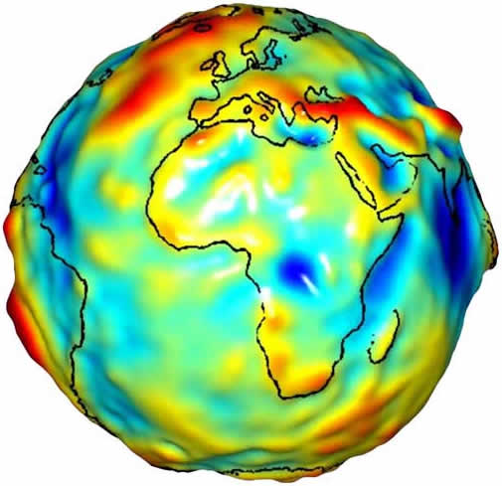
About Geodesy
Geodesy is the science of …
accurately measuring the Earth’s
size, shape, orientation,
gravitational field and
the variations of these with time.
Traditional Geodetic Application:
Precise positioning of points on the surface of the Earth
8
Notes:
8
8

Slide 9
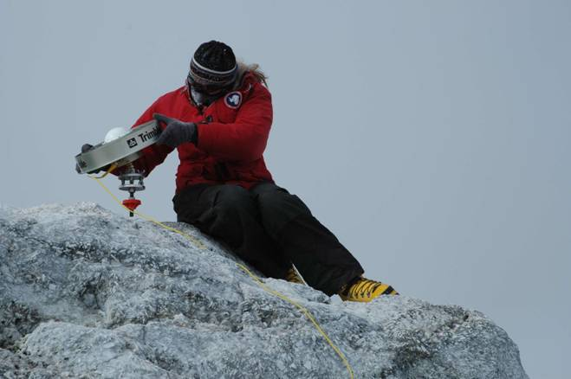
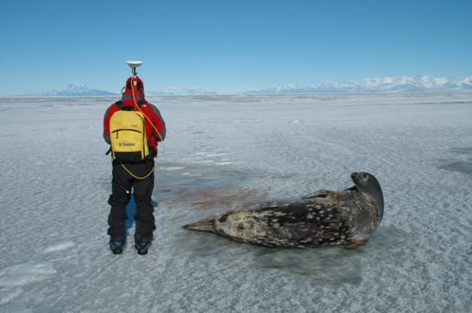
GPS In Extreme Environments

Slide 10
Activity Outcomes
Learners should be able to:
Explain the components of GPS data
Determine velocity vectors from GPS time series plots
Identify uses of GPS in applications in addition to driving and hiking

Slide 11
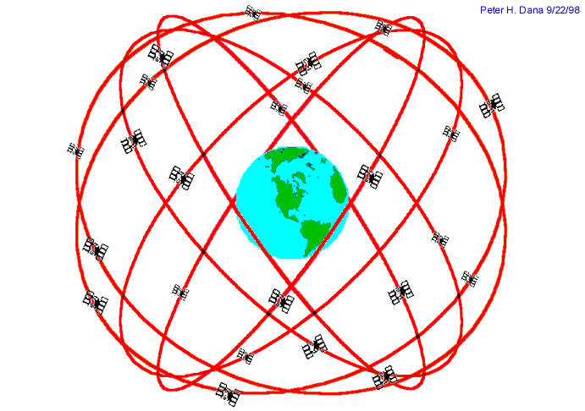
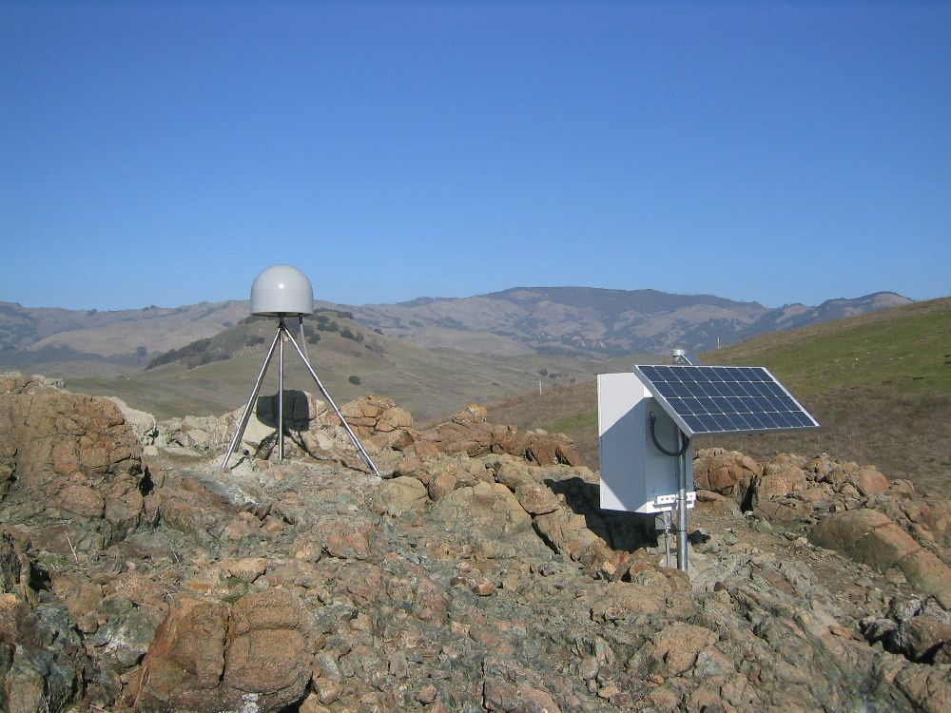
Introduction: GPS Basics
Three satellite signals are needed to locate the receiver in 3D space.
The fourth satellite is used for time accuracy.
Position can be calculated within a sub-centimeter.
Ground control and time quality key to accuracy
Notes:
Also note that the GPS stations used for scientific work are more precise for many reasons: the unit uses both of the signals coming from the satellites, two the clocks are atomic rather than crystal, (see slide). These stations can measure the change in position of a location with sub-centimeter accuracy.

Slide 12
Anatomy of a GPS Station
GPS antenna is inside of dome, solidly attached into the ground with braces. If the ground moves, the station moves.
Solar panel provides power.
Equipment enclosure includes:
GPS receiver
Power/batteries
Communications/radio/modem
Data storage/memory
Notes:
GPS stations are installed permanently into the ground; as the land moves so do the GPS stations.

Slide 13
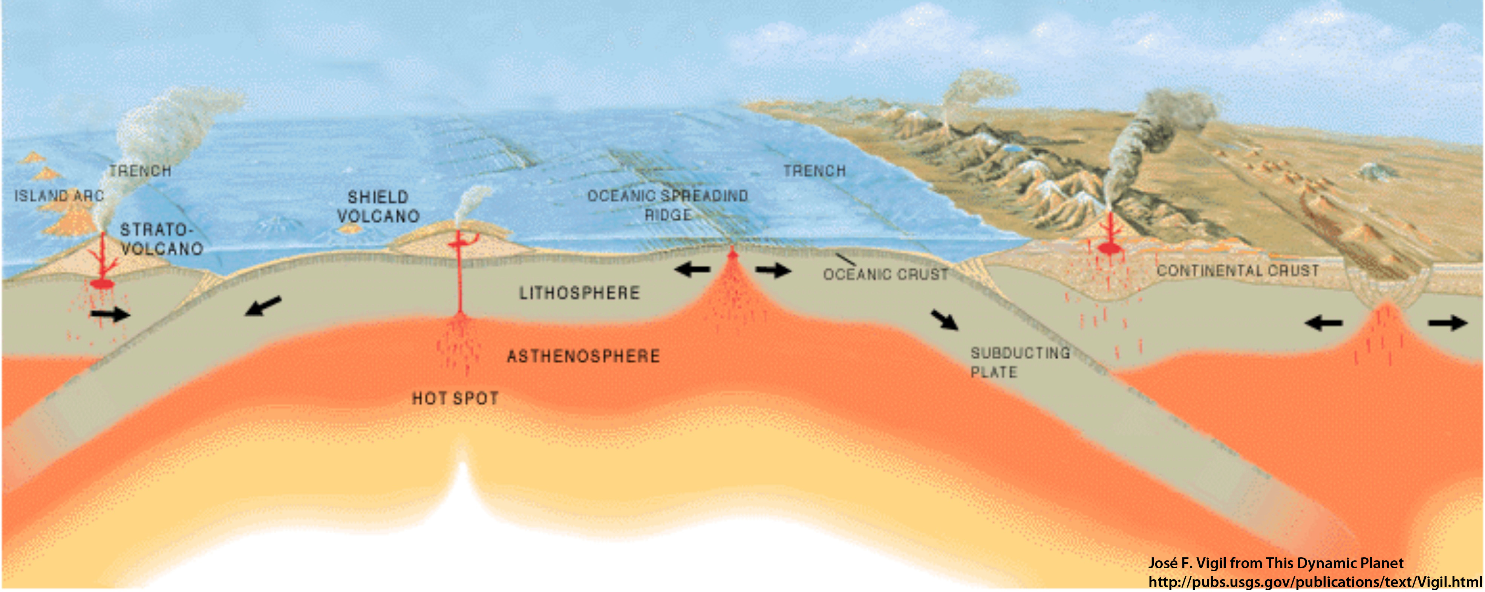
Movement of GPS Stations
GPS station positions change as plates move.
How will these stations’ positions change
relative to one another?

Slide 14
Part 3: Examine GPS Vector Data
GPS station positions change as plates move.
A
B
GPS Station B is moving toward A.
GPS stations are not to scale
Notes:
Note that the red arrow is really just an arrow… there is no scale to show the rate of motion.

Slide 15
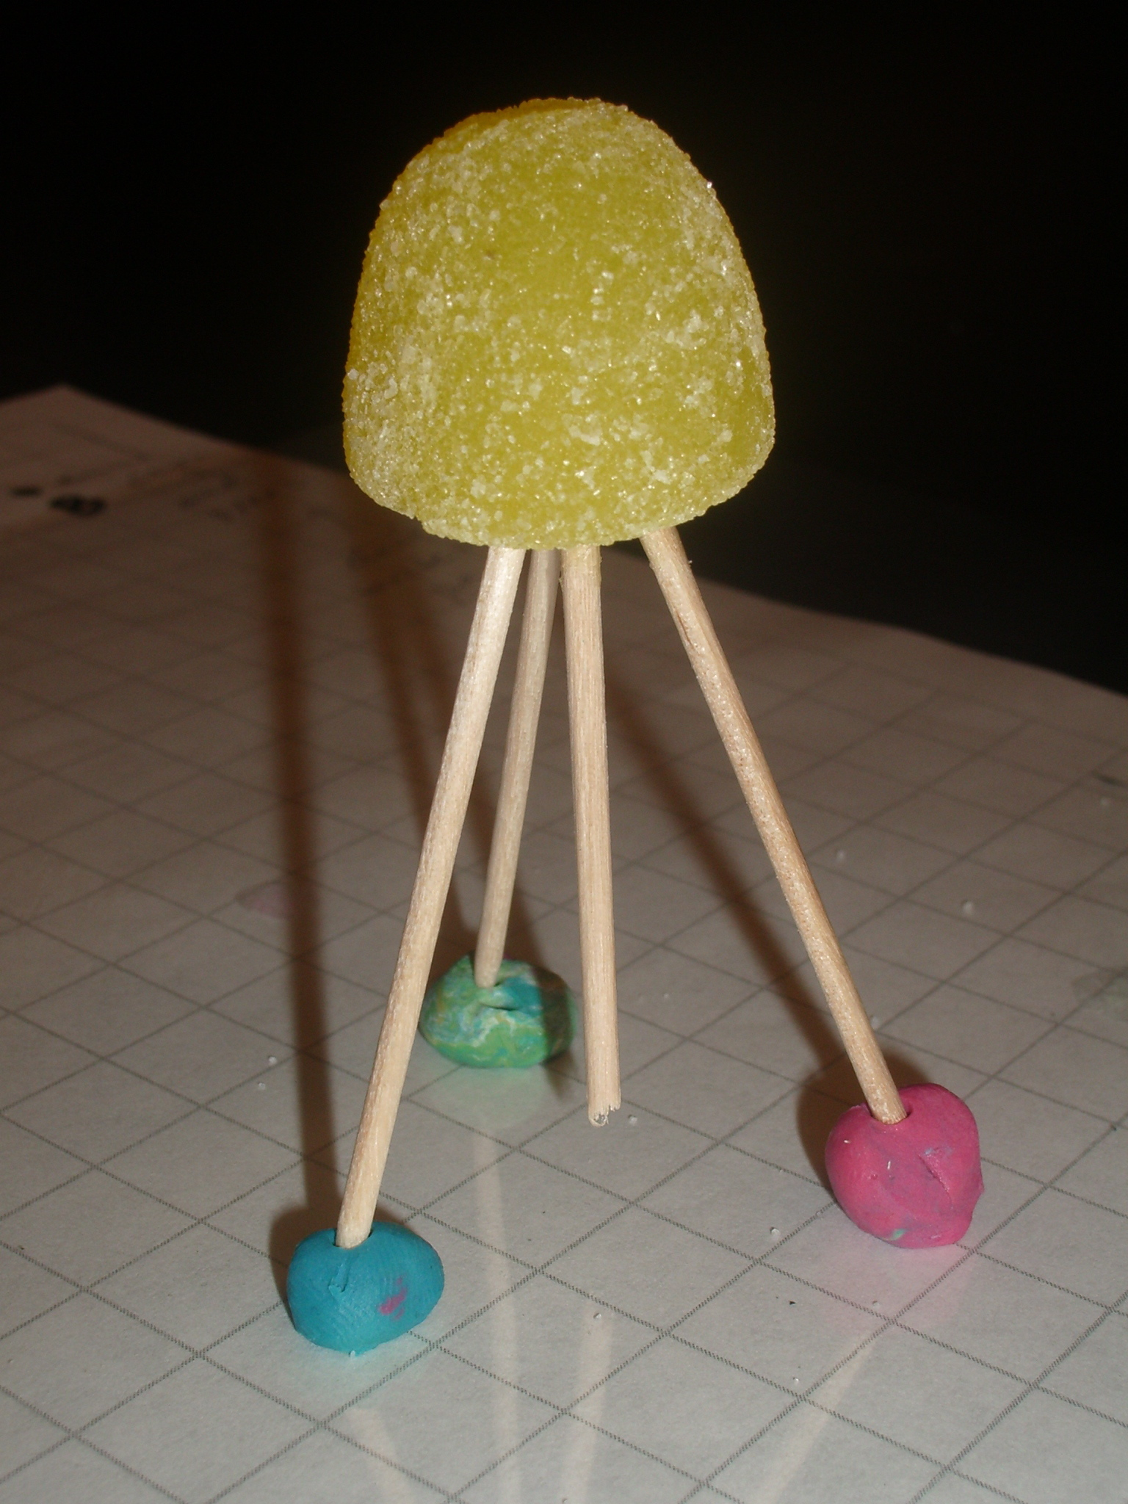

Part 1: Build a Gumdrop GPS Station
To build a gumdrop model of a GPS monument:
  Use one gumdrop as the receiver (GPS monument).
  Use toothpicks as three legs and one center post (monument braces).
  Form feet from three small amounts of clay (Cement).
  Use small piece of transparency paper (‘see-through’ Earth’s plate).
Notes:
Have students write: This is a tectonic plate.

Slide 16
Demonstration
Pinpoint Location With GPS

Slide 17
Part 2: Measure Movement: Processed GPS Data
SBCC GPS STATION
Located near Mission Viejo, CA
Position data collected every 30 seconds
One position estimate developed for each day:
  North
  East
  Vertical
Date | North (mm) | East (mm) | Vertical (mm)
1/1/2004 | -37.67 | 36.57 | 2.33
1/2/2004 | -38.04 | 35.73 | 5.63
1/3/2004 | -37.16 | 35.83 | 4.69
1/4/2004 | -37.34 | 36.34 | 5.36
1/5/2004 | -37.59 | 36.44 | 9.11
… | … | … | …
1/1/2005 | -9.43 | 9.63 | 2.36
1/1/2006 | 16.48 | -18.09 | 7.35
1/1/2007 | 45.98 | -43.42 | -6.43
Notes:
The data from the GPS stations run by UNAVCO's Plate Boundary Observatory (which is one of the EarthScope projects) is freely available to the public. Each GPS station has a data file which contains the daily change in position.
UNAVCO began providing processed data since Jan 1, 2004… Although some GPS stations were installed prior to this date, currently only data after January 1, 2004 is available.

Slide 18
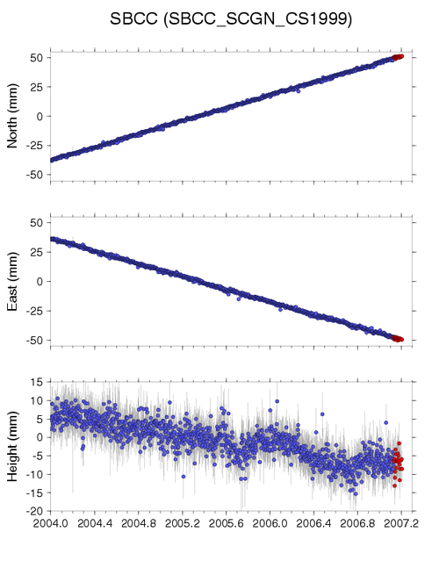
Starting With the Basics:
GPS Time Series Plot
Y-axis:
North (N/S)
East (E/W)
Height (up/down) (sometimes called Vertical)
In millimeters
Red data points are rapid position estimates.
X-axis:
Date of the measurement expressed in tenths of a year or in months.
Notes:
After processing, the data is provided in a coordinate system (latitude and longitude) then converted to millimeters of offset
The beginning of the data is not at zero because the offset is measured from a data point in the middle of the dataset

Slide 19

Units of Measurement
X-axis - Typically expressed in tenths of a year
Y-axis - Usually expressed in millimeters (but always check)
Notes:
Note that the examples we do in this activity use months of the year.

Slide 20
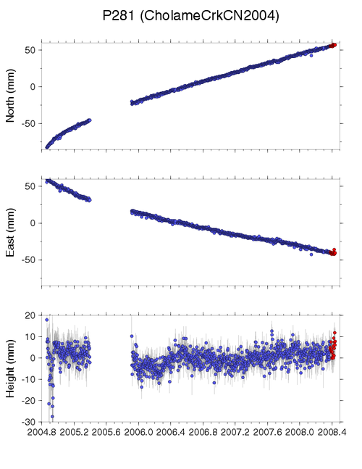
Gaps in Data
Causes:
Power outages
Snow coverage
Equipment failure
Vandalism
Wildlife
Etc.

Slide 21
Determine the direction of movement of high-precision GPS Monument A
GPS Monument A
Year | North (mm) | East (mm) | Height (mm)
2000 | 0 | 0 | 0
2001 | 1 | 1 | 0
2002 | 2 | 2 | 0
2003 | 3 | 3 | 0
2004 | 4 | 4 | 0
2005 | 5 | 5 | 0
… | … | …
Notes:
Leave on screen while students work. Or do so a class
This is slide builds per click – first click shows the points; second click shows the arrow

Slide 22
Plotting the GPS Position Over Time: North
GPS Monument A
North vs Time
Year | North Position (mm)
2000 | 0
2001 | 1
2002 | 2
2003 | 3
2004 | 4
2005 | 5
… | …
5
4
3
2
1
0
North (mm)
2000 2001 2002 2003 2004 2005
Time (years)

Slide 23
Plotting the GPS Position Over Time: North
GPS Monument A
North vs Time
Year | North Position (mm)
2000 | 0
2001 | 1
2002 | 2
2003 | 3
2004 | 4
2005 | 5
… | …
5
4
3
2
1
0
North (mm)
2000 2001 2002 2003 2004 2005
Time (years)

Slide 24
Plotting the GPS Position Over Time: East
GPS Monument A
East vs Time
Year | East Position (mm)
2000 | 0
2001 | 1
2002 | 2
2003 | 3
2004 | 4
2005 | 5
… | …
5
4
3
2
1
0
East (mm)
2000 2001 2002 2003 2004 2005
Time (years)

Slide 25
Plotting the GPS Position Over Time: East
GPS Monument A
East vs Time
Year | East Position (mm)
2000 | 0
2001 | 1
2002 | 2
2003 | 3
2004 | 4
2005 | 5
… | …
5
4
3
2
1
0
East (mm)
2000 2001 2002 2003 2004 2005
Time (years)

Slide 26
Plotting the GPS Position Over Time: Height
GPS Monument A
Height vs Time
Year | Height (mm)
2000 | 0
2001 | 0
2002 | 0
2003 | 0
2004 | 0
2005 | 0
… | …
5
4
3
2
1
0
Height (mm)
2000 2001 2002 2003 2004 2005
Time (years)

Slide 27
Plotting the GPS Position Over Time: Height
GPS Monument A
Height vs Time
Year | Height (mm)
2000 | 0
2001 | 0
2002 | 0
2003 | 0
2004 | 0
2005 | 0
… | …
5
4
3
2
1
0
Height (mm)
2000 2001 2002 2003 2004 2005
Time (years)

Slide 28
Which way are we going?
Are we moving
  North or south?
  East or west?
  Height (or vertical) : up or down?
North (mm)
East (mm)
Height (mm)
Time

Slide 29
Which way are we going?
Moving North and East
Positive slope (numbers getting larger):
  North-south time series: The station is moving north.
  East-west time series: The station is moving east.
  Height time series: The station is moving up.
North (mm)
East (mm)
Height (mm)
Time

Slide 30
Plot North and East Together
GPS Monument A
Year | North (mm) | East (mm)
2000 | 0 | 0
2001 | 1 | 1
2002 | 2 | 3
2003 | 3 | 3
2004 | 4 | 4
2005 | 5 | 5
5
4
3
2
1
0
North
1 2 3 4 5
East
Notes:
Leave on screen while students work. Or do so a class
This is slide builds per click – first click shows the points; second click shows the arrow

Slide 31
What Direction Is GPS Monument A Moving?
Plot the location of the GPS station each year.
Draw an arrow from the first data point to the last data point.
Move your gum-drop GPS monument from year 2000’s position toward 2005’s position.
What direction is your GPS monument moving?
5
4
3
2
1
5
4
3
2
1
5
4
3
2
1
0
North
North
North
1 2 3 4 5
1 2 3 4 5
1 2 3 4 5
East
East
East
Notes:
Leave on screen while students work. Or do as a class
This is slide builds per click – first click shows the points; second click shows the arrow

Slide 32
Part 3: What Direction Is GPS Monument B Moving?
GPS Monument B
Year | North (mm) | East (mm)
2000 | 0 | 0
2001 | -1 | -2
2002 | -2 | -4
2003 | -3 | -6
2004 | -4 | -8
2005 | -5 | -10
Focus on the North data:
Is monument B moving in a more positive or negative direction?
What direction is GPS monument B moving? North or South?
Now, focus on the East data:
Is monument B moving in a more positive or negative direction?
What direction is GPS monument B moving? East or West?
Notes:
Leave overhead while students plot points
This is slide builds per click – first click shows the points; second click shows the arrow

Slide 33
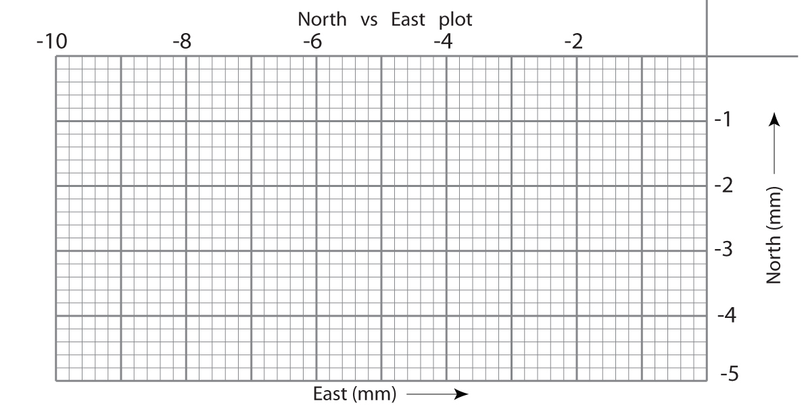
Plotting North and East Positions Together
GPS Monument B
Year | North (mm) | East (mm)
2000 | 0 | 0
2001 | -1 | -2
2002 | -2 | -4
2003 | -3 | -6
2004 | -4 | -8
2005 | -5 | -10
Plot the location of the GPS station each year.
Draw an arrow from the first data point to the last data point.
Move your gum-drop GPS monument from year 2000’s position toward 2005’s position.
What direction is your GPS monument moving?
Notes:
Leave overhead while students plot points
This is slide builds per click – first click shows the points; second click shows the arrow

Slide 34
Plotting North and East Positions Together
GPS Monument B
Year | North (mm) | East (mm)
2000 | 0 | 0
2001 | -1 | -2
2002 | -2 | -4
2003 | -3 | -6
2004 | -4 | -8
2005 | -5 | -10
Notes:
Leave overhead while students plot points
This is slide builds per click – first click shows the points; second click shows the arrow

Slide 35
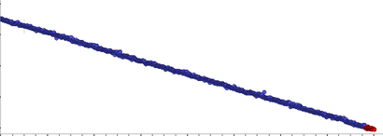
Which way are we going?
Are we moving
  North or south?
  East or west?
  Height (or vertical) : up or down?
North (mm)
East (mm)
Height (mm)
Time

Slide 36
Which way are we going?
Moving South and West
Negative slope:
  North-south time series: The station is moving south.
  East-west time series: The station is moving west.
  Height time series: The station is moving down.
North (mm)
East (mm)
Height (mm)
Time

Slide 37
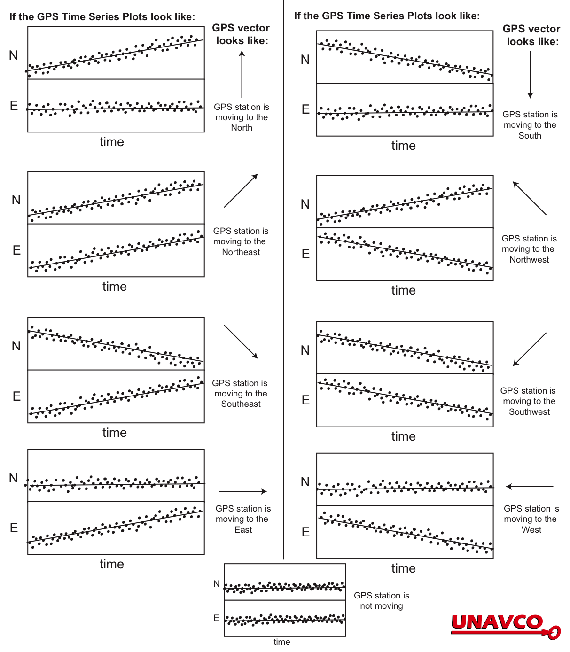
Time Series Plot
Reference Key

Slide 38







Part 3: Apply Your Knowledge: Which Car Matches the Graphs?
A
North
B
E
C
D

Slide 39
Part 3: Apply Your Knowledge: Which Car Matches the Graphs?
i)
What
Direction?
________
Which car?
(letter)
________
North
East
North (miles)
East (miles)
Time (Hours)
Time (Hours)
A
North
B
E
C
D

Slide 40
Which Car Matches the Graphs?
i)
What
Direction?
________
Which car?
(letter)
________
North
East
North (miles)
East (miles)
Time (Hours)
Time (Hours)
A
North
B
E
C
D

Slide 41
Which Car Matches the Graphs?
i)
What
Direction?
________
Which car?
(letter)
________
North
East
North (miles)
East (miles)
Time (Hours)
Time (Hours)
A
North
B
E
C
D

Slide 42
Which Car Matches the Graphs?
i)
What
Direction?
North-Northeast
Which car?
(letter)
Car A
North
East
North (miles)
East (miles)
Time (Hours)
Time (Hours)
A
North
B
E
C
D

Slide 43
Which Car Matches the Graphs? ii
ii)
What
Direction?
________
Which car?
(letter)
________
North
East
North (miles)
East (miles)
Time (Hours)
Time (Hours)
A
North
B
E
C
D

Slide 44
Which Car Matches the Graphs?
ii)
What
Direction?
South
Which car?
(letter)
Car C
North
East
North (miles)
East (miles)
Time (Hours)
Time (Hours)
A
North
B
E
C
D

Slide 45
Which Car Matches the Graphs? iii
iii)
What
Direction?
______
Which car?
(letter)
________
North
East
North (miles)
East (miles)
Time (Hours)
Time (Hours)
A
North
B
E
C
D

Slide 46
Which Car Matches the Graphs?
iii)
What
Direction?
Northwest
Which car?
(letter)
Car B
North
East
North (miles)
East (miles)
Time (Hours)
Time (Hours)
A
North
B
E
C
D

Slide 47
What Direction Is Car E Moving?
iv)
What direction is
Car E moving?
__________
Draw the North and East Graphs
North
East
North (miles)
East (miles)
Time (Hours)
Time (Hours)
A
North
B
E
C
D

Slide 48
What Direction Is Car E Moving?
iv)
What direction is
Car E moving?
East
Draw the North and East Graphs
North
East
North (miles)
East (miles)
Time (Hours)
Time (Hours)
A
North
B
E
C
D

Slide 49
What Direction Is Car D Moving?
v)
What direction is
Car D moving?
_____________
Draw the North and East Graphs
North
East
North (miles)
East (miles)
Time (Hours)
Time (Hours)
A
North
B
E
C
D

Slide 50
What Direction Is Car D Moving?
v)
What direction is
Car D moving?
Southeast
Draw the North and East Graphs
North
East
North (miles)
East (miles)
Time (Hours)
Time (Hours)
A
North
B
E
C
D

Slide 51
Let’s Explore
Data for Educators
  http://www.unavco.org/edu_outreach/data/data.html
UNAVCO Velocity Viewer
  http://facility.unavco.org/data/maps/GPSVelocityViewer/GPSVelocityViewer.html

Slide 52
Conclusion
You should now be able to:
Explain the components of GPS data
Determine velocity vectors from GPS time series plots
Identify uses of GPS in applications in addition to driving and hiking
Explain what is happening to Iceland

Slide 53

Thank you
Contact: Shelley Olds
educationandoutreach unavco.org
http://www.unavco.org/
Follow UNAVCO on facebook
Facebook

Slide 54
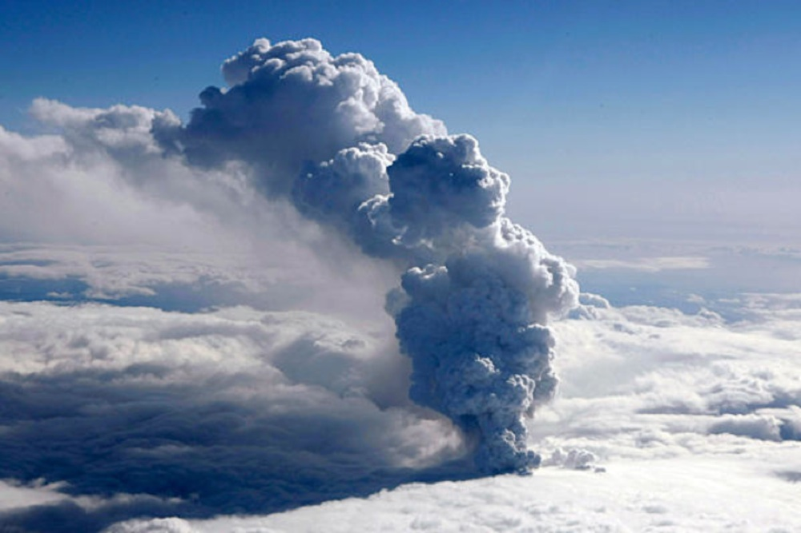
Iceland…

Slide 55
Exploring Plate Motion and Deformation in California Using GPS Time Series Plots
Cate Fox-Lent, UNAVCO Master Teacher; Andy Newman, Georgia Institute of Technology;
Shelley Olds, UNAVCO

Slide 56
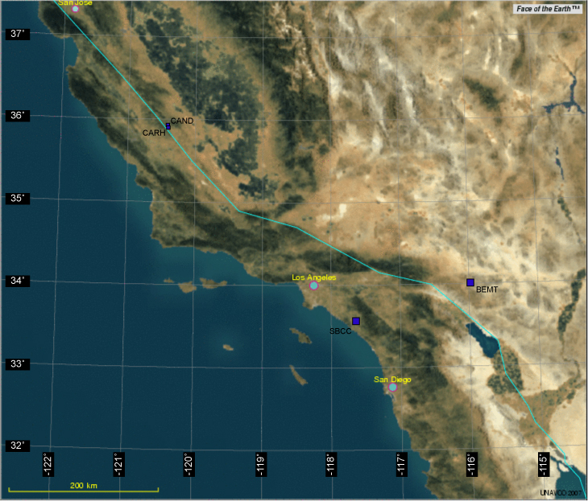
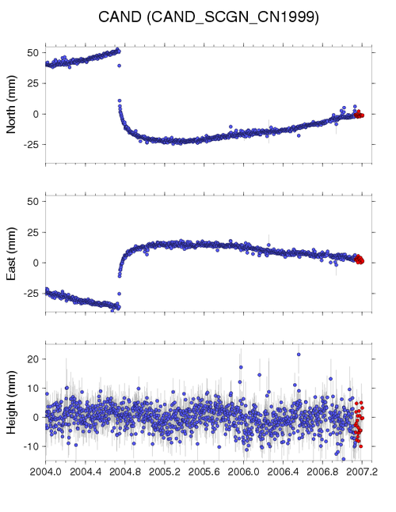
Parts of the Activity
Part 1: Analyze authentic GPS data at two stations to determine plate tectonic motions
Part 2: Investigate deformation at two GPS stations in California
Extension: Explore More GPS locations
BEMT
SBCC

Slide 57
Activity Outcomes
Learners should be able to
Discuss high-precision GPS and its application to plate tectonics.
Interpret GPS time series plots to determine regional plate velocity
Describe the plate motions along the San Andreas
Access resources to support classroom implementation

Slide 58
Processed Data
SBCC GPS STATION
The station is located near Mission Viejo, CA.
Position data are collected every 30 seconds.
One position estimate is developed for each day:
  North
  East
  Vertical
Date | North (mm) | East (mm) | Vertical (mm)
1/1/2004 | -37.67 | 36.57 | 2.33
1/2/2004 | -38.04 | 35.73 | 5.63
1/3/2004 | -37.16 | 35.83 | 4.69
1/4/2004 | -37.34 | 36.34 | 5.36
1/5/2004 | -37.59 | 36.44 | 9.11
… | … | … | …
1/1/2005 | -9.43 | 9.63 | 2.36
1/1/2006 | 16.48 | -18.09 | 7.35
1/1/2007 | 45.98 | -43.42 | -6.43
Notes:
The data from the GPS stations run by UNAVCO's Plate Boundary Observatory (which is one of the EarthScope projects) is freely available to the public. Each GPS station has a data file which contains the daily change in position.
UNAVCO began providing processed data since Jan 1, 2004… Although some GPS stations were installed prior to this date, currently only data after January 1, 2004 is available.

Slide 59
Position Time Series Plot
The time series plot shows the GPS station’s change in position over time.
X-axis:
  Date of the measurement
  In 10ths of year or months
Y-axis:
  North (N/S)
  East (E/W)
  Height (up/down) (sometimes called Vertical)
  In millimeters

Slide 60
Units of Measurement
X-axis is typically shown in 10ths of year.
Y-axis is typically shown in millimeters (but always check).
Notes:
Note that the examples we do in this activity use months of the year.

Slide 61
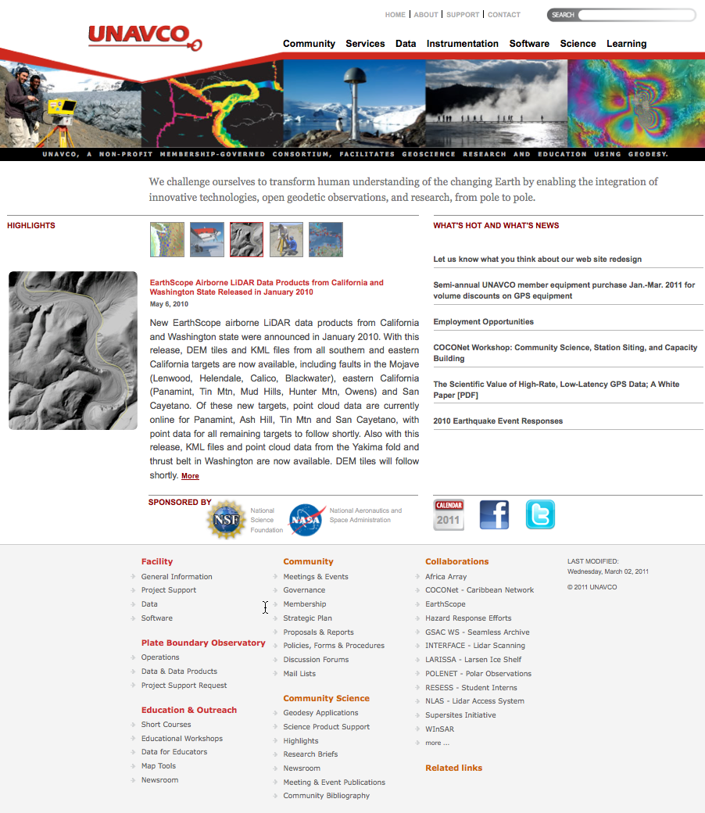
Part 1: Analyze Authentic
Time Series Data of Two GPS Stations
Go to: http://www.unavco.org/
Click on Data for Educators

Slide 62
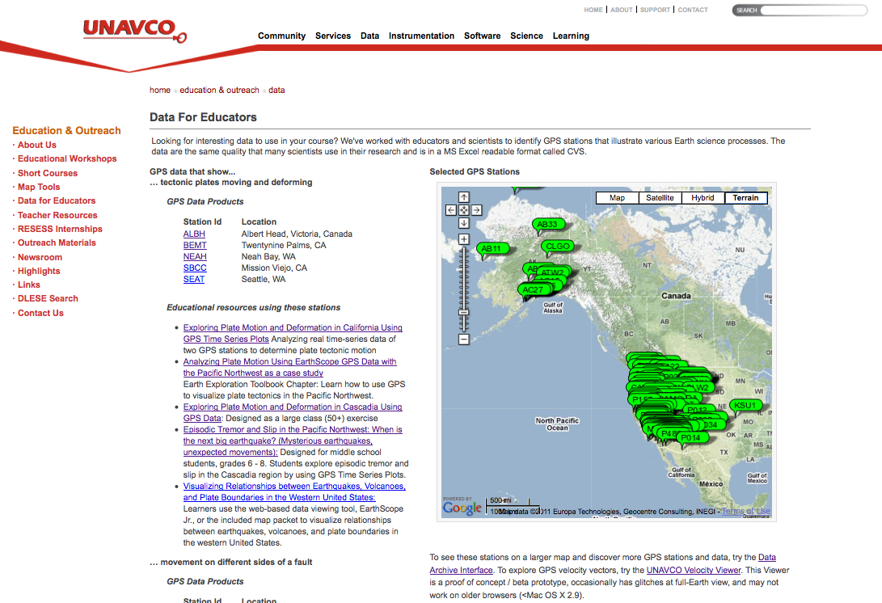
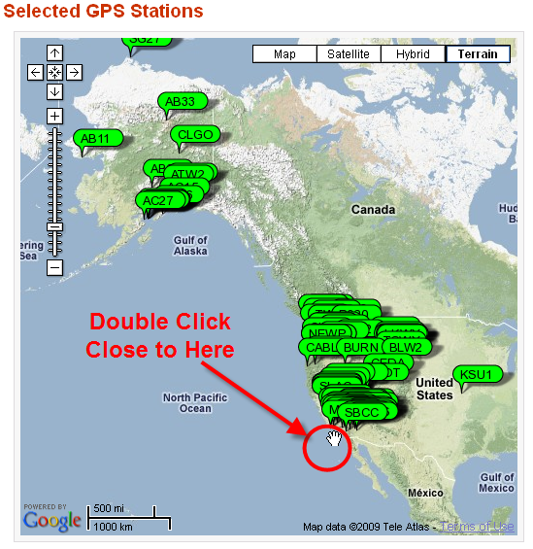
Data for Educators Website
2. Zoom in near Southern California – BEMT and SBCC

Slide 63
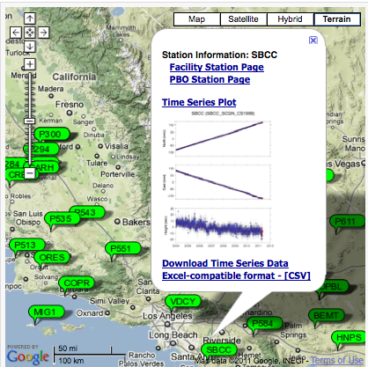
Station information
3. Click on the green balloon labeled SBCC or BEMT (near Los Angeles)
Click on the link for PBO Station Page
Notice:
Station information pages
Time Series Plot
Link to download data

Slide 64
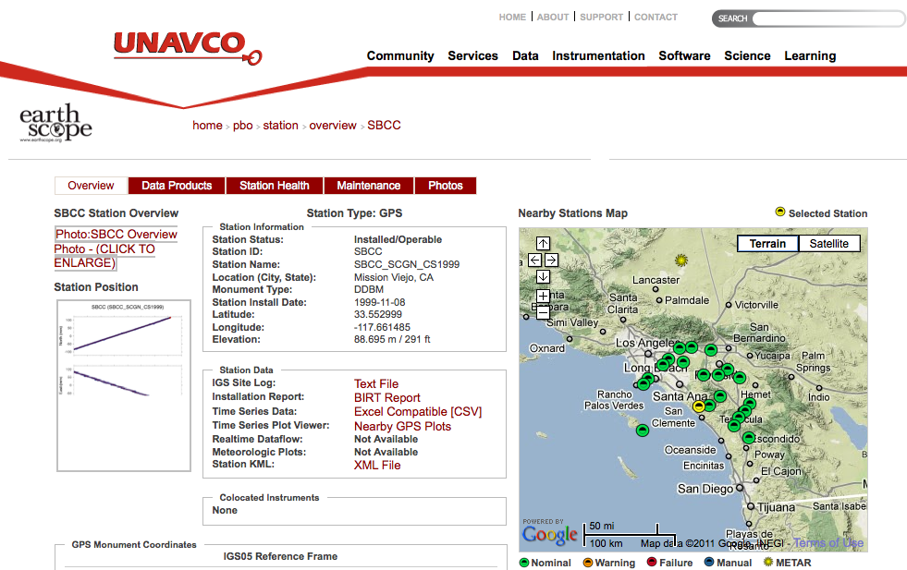
Overview Page
4. Use the information to retrieve the station information and time series plot graph

Slide 65
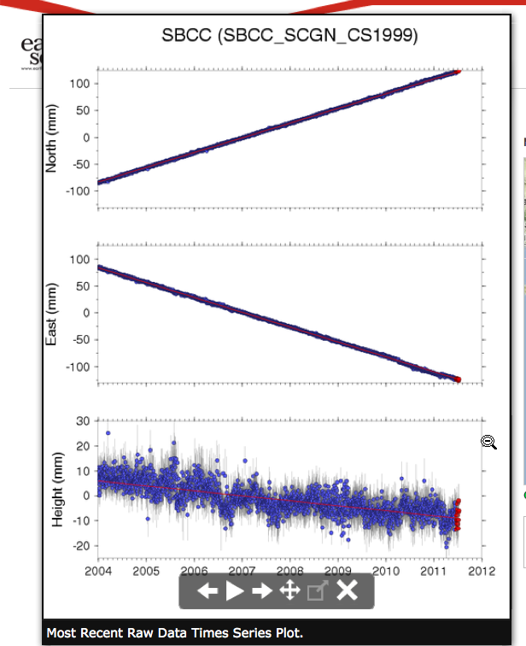
Overview Page
5. Work with a partner to answer questions 4 – 5 about BEMT and SBCC
Hints:
Elevation: use the elevation listed under SNARF
Use the Station Position plot titled: Most Recent Raw Data Times Series Plot.

Slide 66
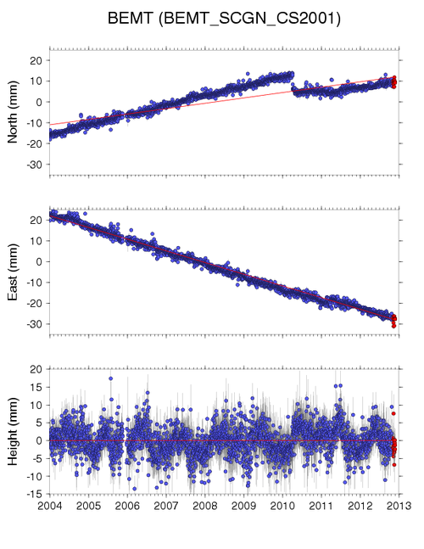
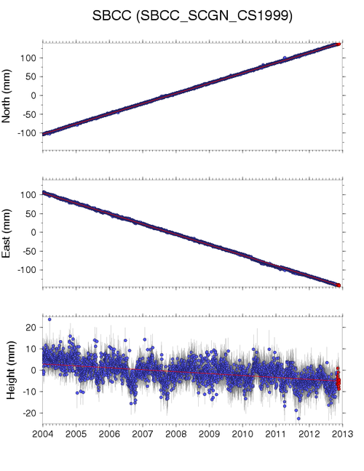
GPS Monument BEMT
What are the units of measurement for these time series?

Slide 67
How Quickly is BEMT moving?
How quickly is BEMT moving in the North-South direction?
Let’s look at 2005 and 2010
Average position on 1/1/2010 = ______ mm
Average position on 1/1/2005 = ______ mm
Hint: sketch in light vertical lines from 2005 and 2010 up to the plot, then a horizontal line from the plot to the y-axis
Notes:
Do the North motion as a class.
Have students follow along on their worksheet – drawing the lines across and down seem to help.

Slide 68
How Quickly is BEMT moving?
How quickly is BEMT moving in the North-South direction?
Let’s look at 2005 and 2010. What general direction is BEMT moving?
Average position on 1/1/2010 = __14 __ mm
Average position on 1/1/2005 = __-10 _ mm
Annual speed of BEMT north = (13 - ⁻9 mm)/5 years = 24 mm/5yrs
= 4.8 mm/yr to the North for BEMT (+/- 0.2?)
Notes:
Do the North motion as a class.
Have students follow along on their worksheet – drawing the lines across and down seem to help.

Slide 69
How Quickly is BEMT moving?
How quickly is BEMT moving in the East-West direction?
Let’s look at 2005 and 2010. What general direction is BEMT moving?
Average position on 1/1/2010 = ______ mm
Average position on 1/1/2005 = ______ mm
Hint: sketch in light vertical lines from 2005 and 2010 up to the plot, then a horizontal line from the plot to the y-axis
Notes:
Do the North motion as a class.
Have students follow along on their worksheet – drawing the lines across and down seem to help.

Slide 70
How Quickly is BEMT moving?
How quickly is BEMT moving in the North-South direction?
Let’s look at 2005 and 2010
Average position on 1/1/2010 = __-9 __ mm
Average position on 1/1/2005 = __17 _ mm
Annual speed of BEMT north = ( ⁻9 - 17 mm)/5 years = -26 mm/5yrs
= -5.2 mm/yr. BEMT is moving to the West
Notes:
Do the North motion as a class.
Have students follow along on their worksheet – drawing the lines across and down seem to help.

Slide 71
How Quickly is SBCC moving?
Now do SBCC
Annual speed of SBCC
= 27 mm/yr to the North
= ~28 mm/yr to the West
Notes:
Do the North motion as a class.
Have students follow along on their worksheet – drawing the lines across and down seem to help.

Slide 72
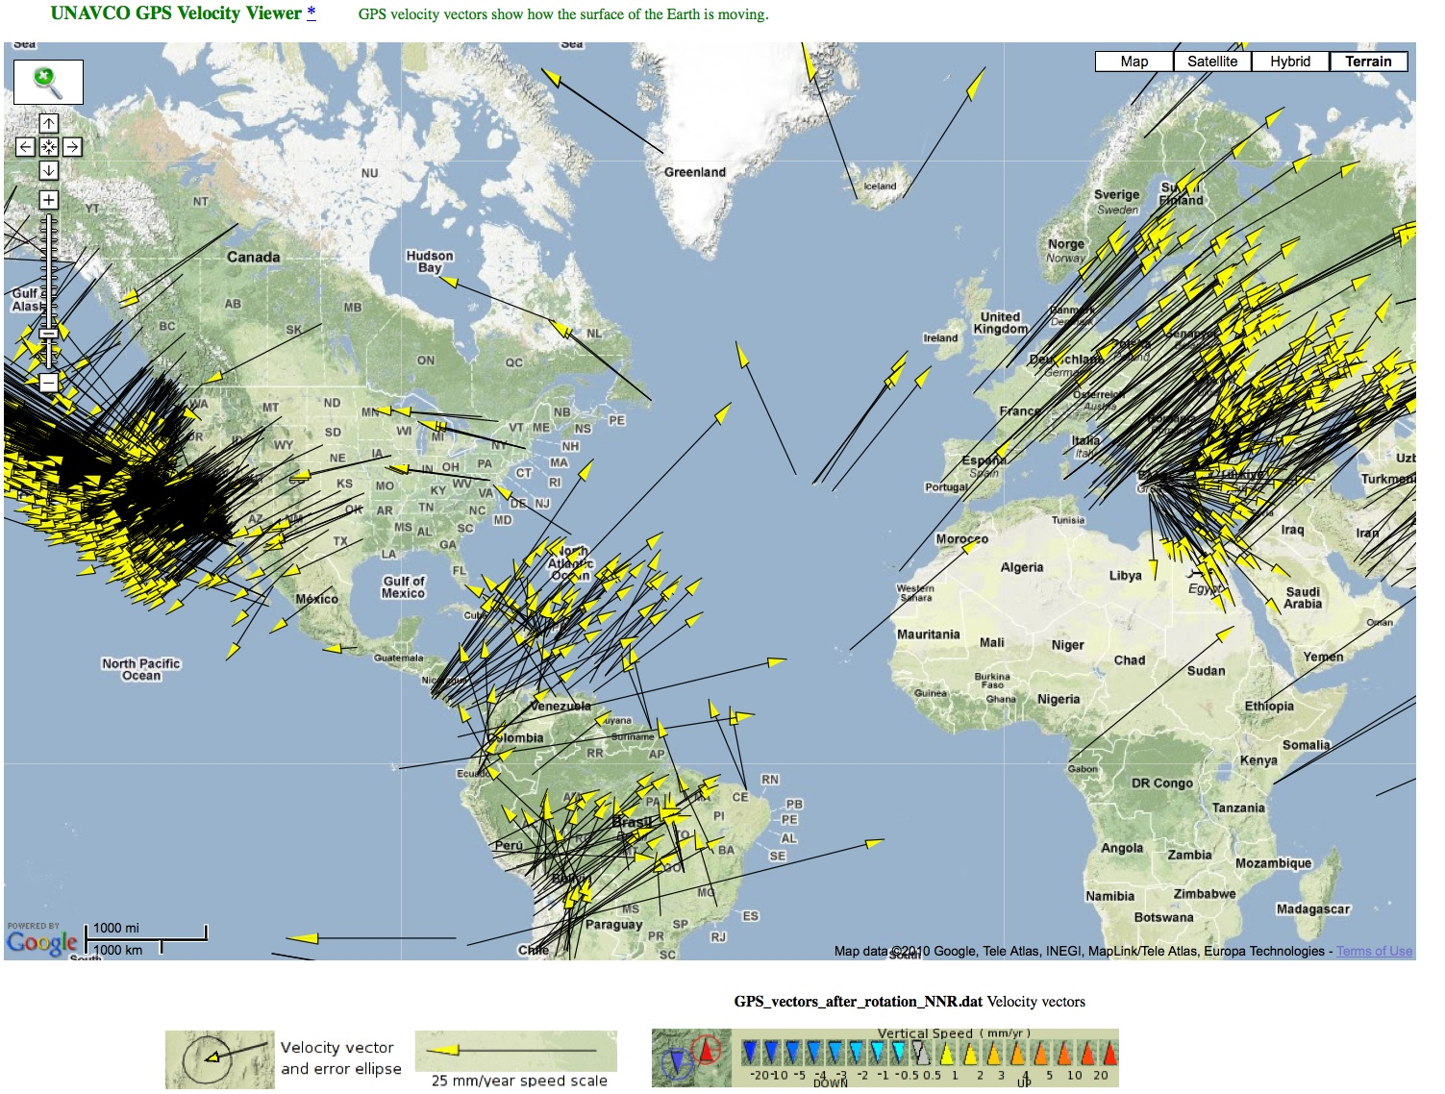
How do we show the movement of plates on a map?
… with Vectors!

Slide 73
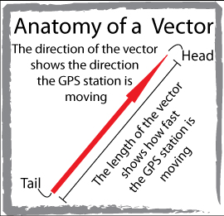
What’s a vector?
A vector shows:
magnitude (speed) and
direction (of motion).
Vector’s tail = starting location of the GPS monument.
Direction the vector points = direction the GPS station is moving.
Length of the vector = how fast the GPS station is moving

Slide 74
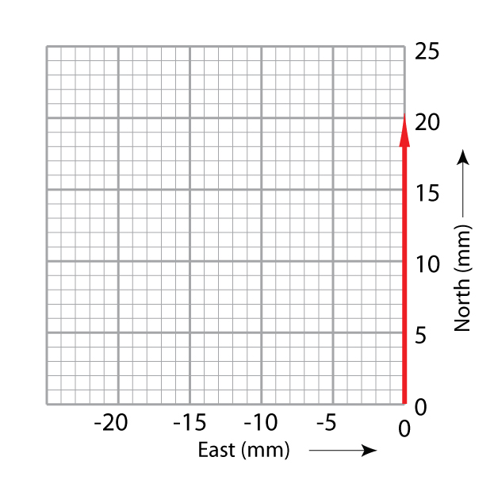
Graph paper as a map
Each axis uses the same scale.
X-axis: East in millimeters
Y-axis: North in millimeters
On your graph paper, each block represents 1 mm.
Where is the origin on this graph paper?
Notes:
It is very important that both the North and East axis use the same scale so that the two vectors can be added together.
Have students work in pairs – check each other’s work.

Slide 75
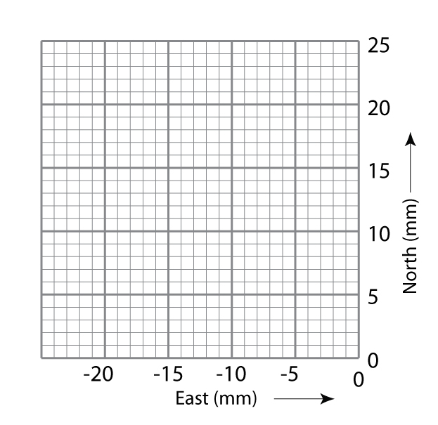
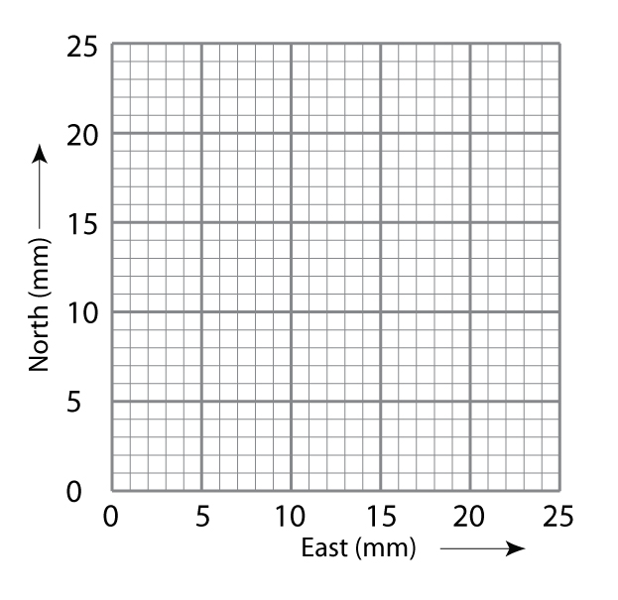
North vs East Graph Paper: it’s a map!

Slide 76
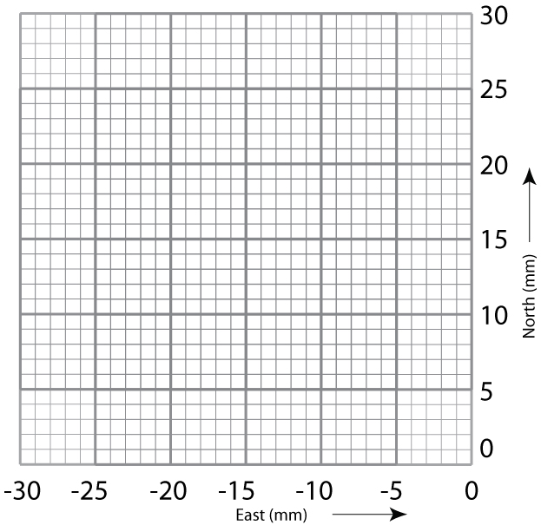
Plotting Vectors: North
Vector: magnitude and direction
  Tail is the GPS monument location.
  Length of arrow is the magnitude.
  Shows direction on a map
Notes:
It is very important that both the North and East axis use the same scale so that the two vectors can be added together.
Have students work in pairs – check each other’s work.

Slide 77
Plotting Vectors: North
Step 1. Draw the first vector arrow along the North axis with the tail at 0,0.
GPS Monument BEMT has moved 4.8 mm to the North per year
Draw a vector arrow 4.8 blocks along the north axis.
Notes:
It is very important that both the North and East axis use the same scale so that the two vectors can be added together.
Have students work in pairs – check each other’s work.

Slide 78
Plotting Vectors: East
Step 2. Draw the east vector from the end point of the North arrow.
(Remember to draw vectors with negative values in the opposite direction.)
Draw the vector arrow ⁻5.2 blocks (mm)
Notes:
It is very important that both the North and East axis use the same scale so that the two vectors can be added together.
Have students work in pairs – check each other’s work.

Slide 79
Adding the Vectors Together
Step 3. Add the vectors together by drawing a new vector from the origin (0,0) to the end point of the East arrow.
This final vector shows the overall annual direction and distance of motion of the GPS station and the land beneath it.
Notes:
It is very important that both the North and East axis use the same scale so that the two vectors can be added together.
Have students work in pairs – check each other’s work.

Slide 80
Adding the Vectors Together
To add the vectors together, mathematically:
  GPS Monument moves at: √x² + ⁻y² = 7.1 mm/yr to the _Northwest_
Notes:
Students can move their gum-drop GPS stations along the final vector (in red) to get the feel of the movement of the GPS.
Reiterate that the GPS is moving because the Earth’s plate is moving.
Talk through this.

Slide 81
Plot the vectors on the map
BEMT:
  4.8 mm N
  -5.2 mm E
SBCC:
  27.2 mm N
  -27.8 mm E
BEMT
SBCC

Slide 82
Velocity of Plates
BEMT:
  4.8 mm N
  -5.2 mm E
SBCC:
  27.2 mm N
  -27.8 mm E
BEMT
SBCC

Slide 83
Velocity of Plates:
Adding the Vectors
BEMT:
  4.8 mm N
  -5.2 mm E
  = 7.1 mm/yr to the northwest
SBCC:
  27.2 mm N
  -27.8 mm E
  = 38 mm/yr to the northwest
BEMT
SBCC
SBCC is moving ~5 times more quickly than BEMT.

Slide 84
Wait a minute!
This Is a Transform Fault!
Why are the vectors pointing in the same direction?
BEMT
SBCC
SBCC is moving ~5 times more quickly than BEMT.
SBCC is moving ~5 times more quickly than BEMT.

Slide 85
This Is a Transform Fault!
Huh? Remember, these velocities are relative to the North American Reference Frame:
BEMT = ~7.1 mm/yr to the northwest
SBCC = ~38 mm/yr to the northwest
Imagine you are on a three-lane highway, driving in the middle lane…
BEMT
SBCC
SBCC is moving ~5 times more quickly than BEMT.

Slide 86
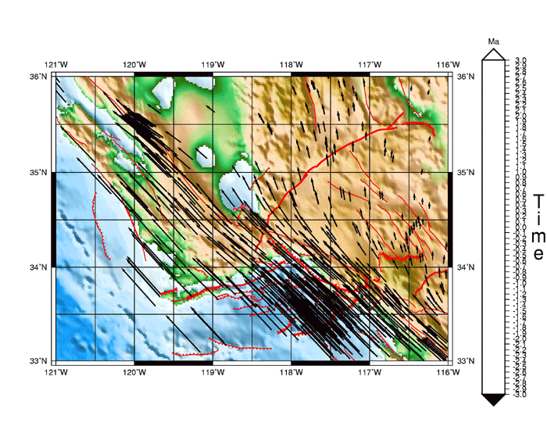
Animation: Modeling the
Past and Future
+3 million yrs
Now
-3 million yrs
Press space bar to start animation.
Source: http://rock.geo.sunysb.edu/~holt/Education/vel6Ma.html

Slide 87
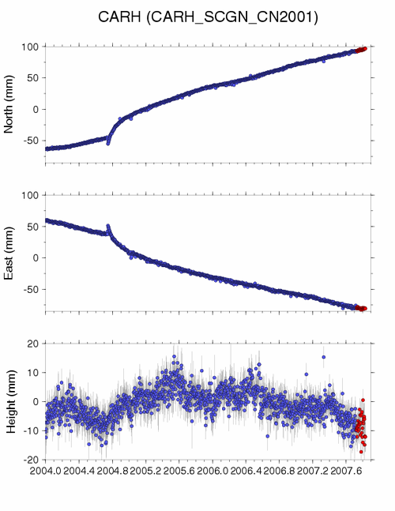
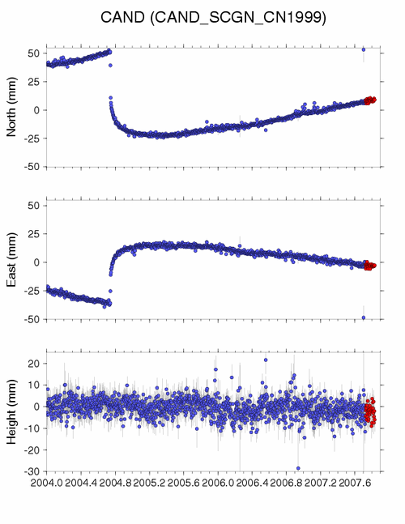

What’s Happening Here?

Slide 88
Teaching Tips/Challenges
What teaching tips to implement this lesson?
What sources of error would your students have?

Slide 89
Questions
Contact: Shelley Olds
educationandoutreach unavco.org
http://www.unavco.org/
Follow UNAVCO on facebook
Facebook Twitter

Slide 90
Part 2: Investigate Deformation at Two GPS Stations in California
CAND:
  Lat: 35.94
  Long: -120.43
CARH
  Lat: 35.89
  Long: -120.43
CAND
CARH

Slide 91
Anyone Have a Calculator?
How much slip on the fault occurred during the event using the CAND time series plot?
  ~ 75 mm south and ~ 60 mm east resulting in 96 mm combined slip to the southeast
How does the CAND GPS station’s position change?
  During the earthquake.
  After the earthquake.
What was the magnitude* of the Parkfield earthquake based on the slip that you calculated?
Sudden change in position to SE…
Continued SE until ~Jan 2005, then resumed NW movement
M = log₁₀(D) + 6.32
0.9
where M = magnitude
D = average slip in meters
[1000 mm = 1 meter]
M = log₁₀(.096) + 6.32
0.9
M = 5.9
(according to the USGS, the Parkfield earthquake was a magnitude 6.0 Mw)
Notes:
Answers appear after each click
Note: Moment magnitude is the most widely used method for calculating the size of an earthquake by seismologists, and is proportional to the energy released by the earthquake. A common misconception is that the Richter Scale is still in use – it has been replaced. Richter Scale was developed only for earthquakes in California within a specific range.

Slide 92
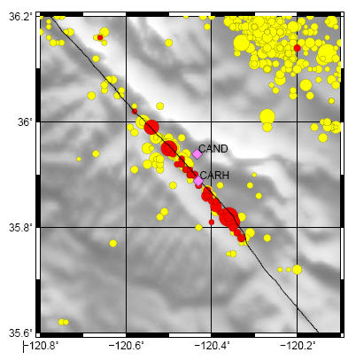
Reoccurring Earthquakes
~96 mm total slip
Plate moving –~22mm/yr at Parkfield
How long should it take to build enough strain energy to generate an earthquake with a similar magnitude?
  96mm/22 mm per year = ~4.4 years
Area map of Parkfield: USGS
Red = Epicenters of the main shock and aftershocks within one month of event
Yellow = Epicenters of earthquakes from 1973–2006

Slide 93
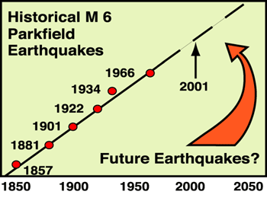
Reoccurring Earthquakes
Observed frequency of M6 earthquakes during the 20th century?
  ~every 20 years
Predicted frequency:
  96mm / 22 mm per year = ~4.4 years
Why are these numbers different?
  Smaller earthquakes release some of the strain.
  There are interactions with nearby faults, etc.

Slide 94
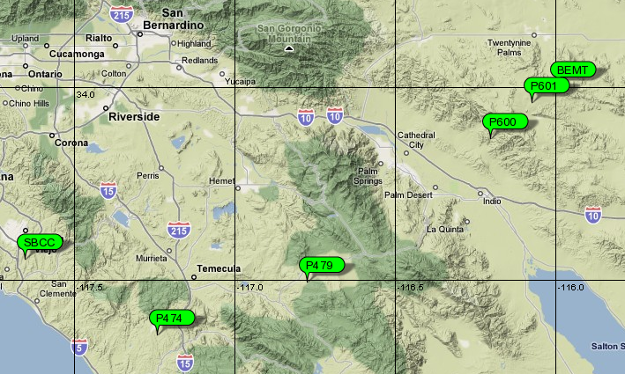
Extension: Explore More GPS Locations

Slide 95
Other Tools to Explore
UNAVCO GPS, Earthquake, Volcano Viewer
  http://geon.unavco.org/unavco/GEV.php
Google Earth: Learn About Plate Tectonics
  http://geon.unavco.org/unavco/GE/Learn_about_Plate_Tectonics.kmz
IRIS Earthquake Browser
  http://www.iris.washington.edu/servlet/eventserver/map.do

Slide 96
Extra slides:
Slides on reference frames
Slides to with a simple example for graphing North vs Time and East vs Time

Slide 97
Iceland…

Slide 98
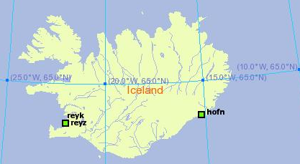
Part 2: Real GPS Data:
Surprising Discoveries About Iceland
HOFN
REYK

Slide 99
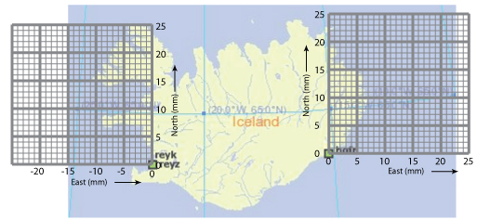
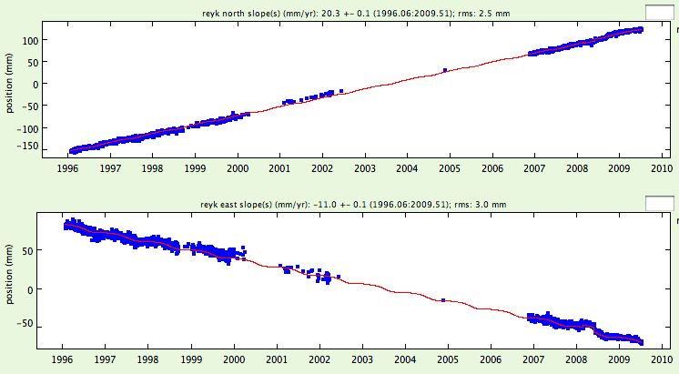
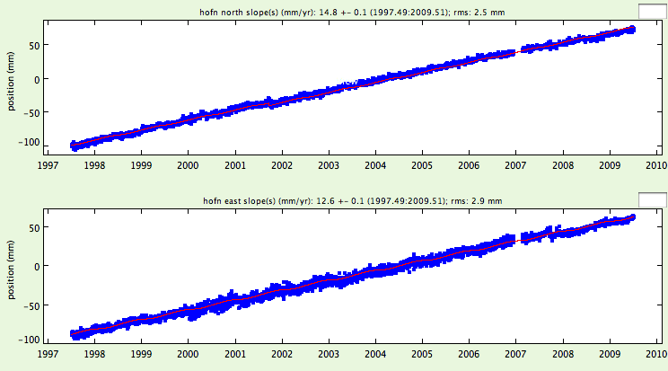
What does the GPS data show us?
REYK
HOFN
North (mm)
North (mm)
East (mm)
East (mm)

Slide 100
REYK and HOFN
There has to be an easier way to show this!
North: 20.5 mm/yr
East: -11 mm/yr
North: 15 mm/yr
East: 13 mm/yr
HOFN
REYK
REYK
HOFN
North (mm)
North (mm)
REYK North = 20.5 mm/year
HOFN North = 15.0 mm/year
East (mm)
East (mm)
REYK EAST = ⁻11.0 mm/year
HOFN EAST = 13.0 mm/year
Notes:
Are they moving…
Now think about a map that had many GPS stations on it. And each one had the two numbers for north and east on there… it would get very complicated. There has to be a better way!

Slide 101
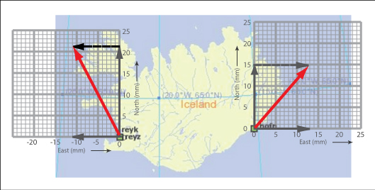
What Is Happening to Iceland?

Slide 102
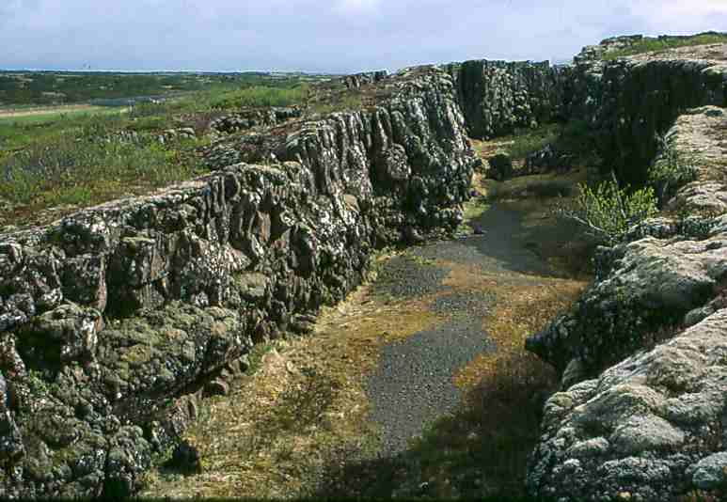
The fracture pictured here occurs over the Mid-Atlantic Ridge. The photo by R. Stull was taken immediately after the largest earthquake in the area since 1917.
www.calstatela.edu/dept/geology/HotSpots.htm

Slide 103
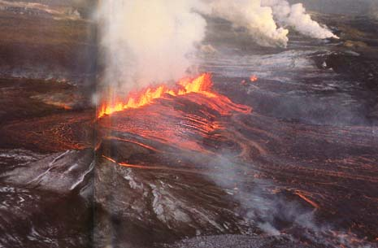


And what happens when plates move apart? Lava…
Icelandic rift eruption
(Photo: National Geographic Magazine)
Sites of surface eruptions
Vestmanneyjar, Heimaey, Iceland January 1973
Source: USGS

Slide 104

Iceland and the Mid-Atlantic Ridge
ICELAND
Mid-Atlantic
Ridge

Slide 105
Other Tools to Explore
UNAVCO GPS, Earthquake, Volcano Viewer
  http://facility.unavco.org/data/maps/GPSVelocityViewer/GPSVelocityViewer.html
Google Earth: Learn About Plate Tectonics
  Link is on: http://www.unavco.org/edu_outreach/data/data.html
IRIS Earthquake Browser
  http://www.iris.edu/ieb

Slide 106

Neighboring Frames of Reference: North America
Reference frame North America (SNARF) which means:
The rest of the world’s plates move, while the North America plate stays fixed.
Near Alaska, the vector arrows are pointing to the North West (NW) because the Pacific plate is moving to the NW…
and the edge of Alaska is also moving NW
Notes:
Leet’s see how a frame of reference changes your view.
Under Add velocities is a list of the tectonic plates. Typically scientists look at the velocities using a reference frame near where they are looking. In the example above, looking at Alaska, scientists might choose either the Pacific plate or North America reference frames to investigate how the velocities change – sometimes you see surprising subtle features by doing this! For instance, by using the North America reference frame, you can see that the very edge of Alaska is being pushed inland due to the subducting Pacific plate

Slide 107

Neighboring Frames of Reference: Pacific Plate
Pacific plate as reference frame:
Pacific plate doesn’t move
Near Alaska, the vector arrows point South East
Alaska is moving to the South East…

