Slide 1
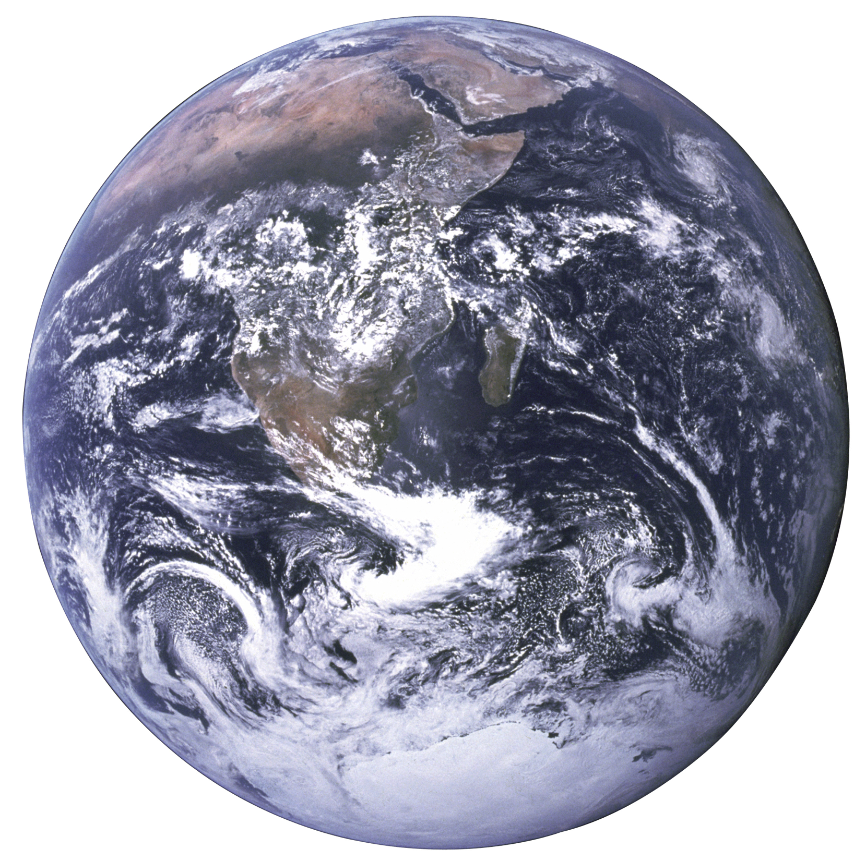
Changing Planet −
Earth and Life Through Time
2014 GIFT Workshop
Mark Nielsen, Howard Hughes Medical Institute
Heather Olins, Harvard University

Slide 3
Website link:
www.BioInteractive.org

Slide 5

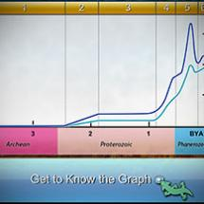
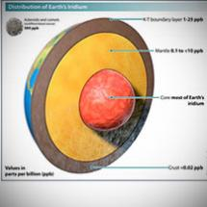
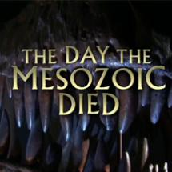
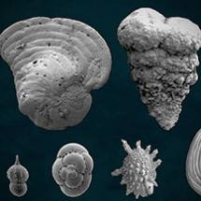
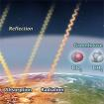
Understanding life on Earth must include an understanding of how biology interacts with the environment.
Our resources highlight the long and dynamic history of the Earth and how life has shaped —and been shaped by— the environment.
Classroom
Activities
Lectures
Interactives
Short Films
Posters
Animations

Slide 6
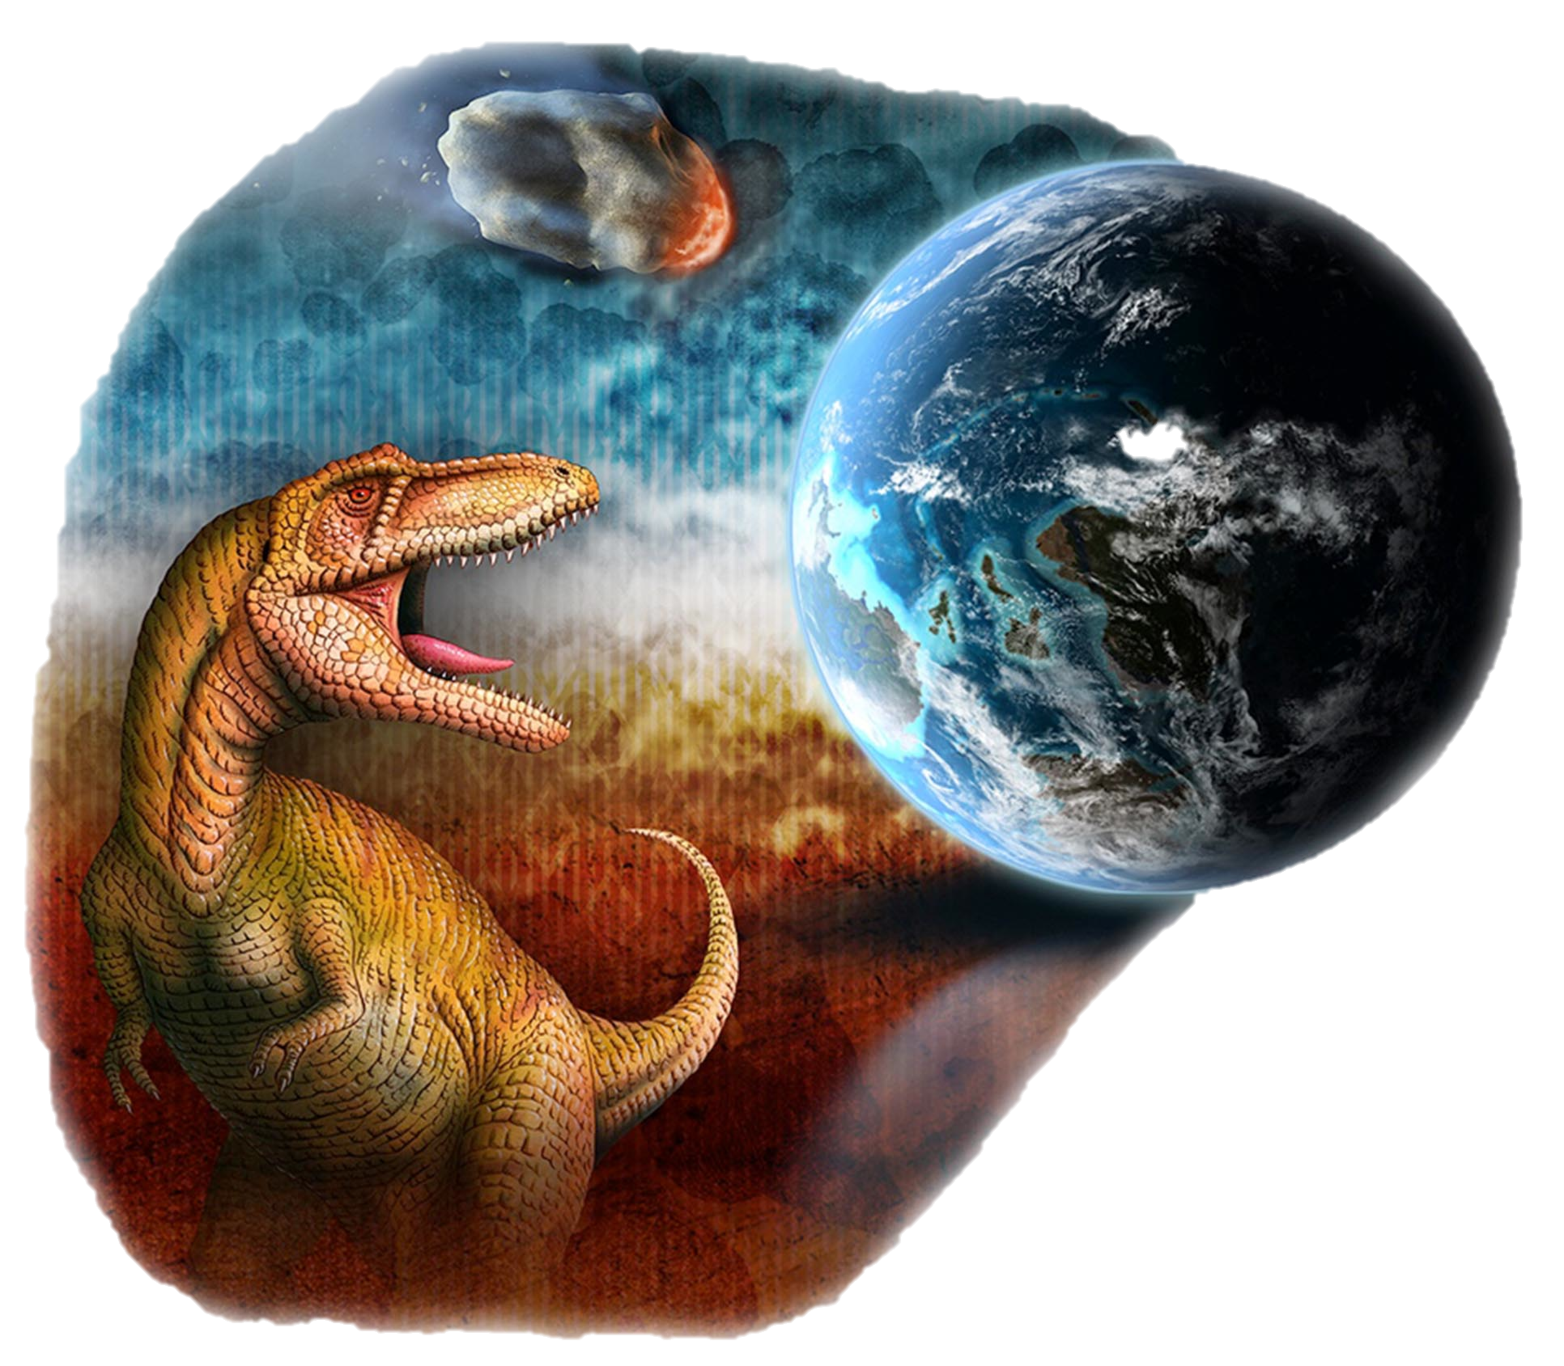
OUTLINE FOR TODAY
The Day the Mesozoic Died
Finding the Crater Classroom Activity
EarthViewer – exploring climate concepts with a mobile app
Questions and Evaluations

Slide 7
The Day the Mesozoic Died
“This film is intended to engage all students in all science classes.”
At a Glance Film Guide

Slide 8
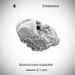
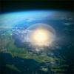
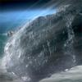
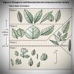

The Day the Mesozoic Died
Classroom Resources
At A Glance Film Guide
Quiz
In Depth Guide
The Day the Mesozoic Died—article
Distribution of Elements in Earth’s Crust
Chemical Signature of an Asteroid
Determining the Size and Energy of the K-T Asteroid
Calculating Iridium Fallout From an Asteroid Impact
Weighing the Evidence for a Mass Extinction

Slide 9
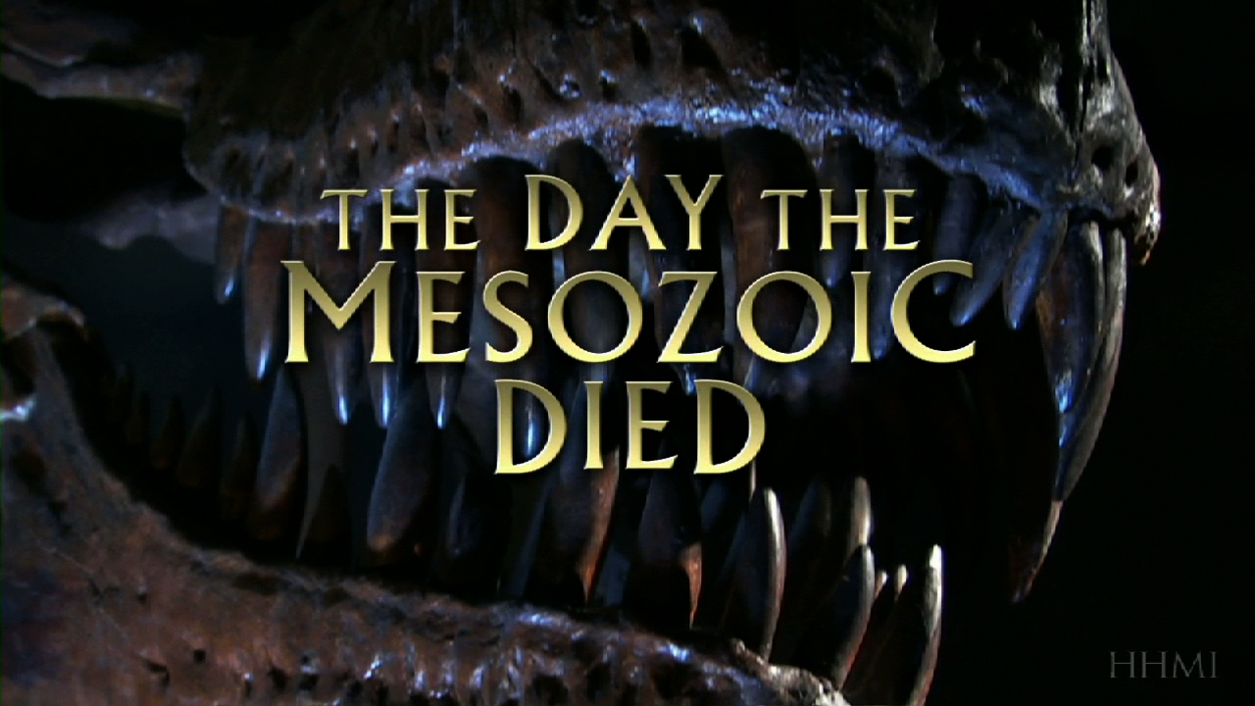
Short film can be streamed or downloaded from:
http://www.hhmi.org/biointeractive/day-mesozoic-died

Slide 10
Activity link:
http://www.hhmi.org/biointeractive/finding-crater

Slide 11
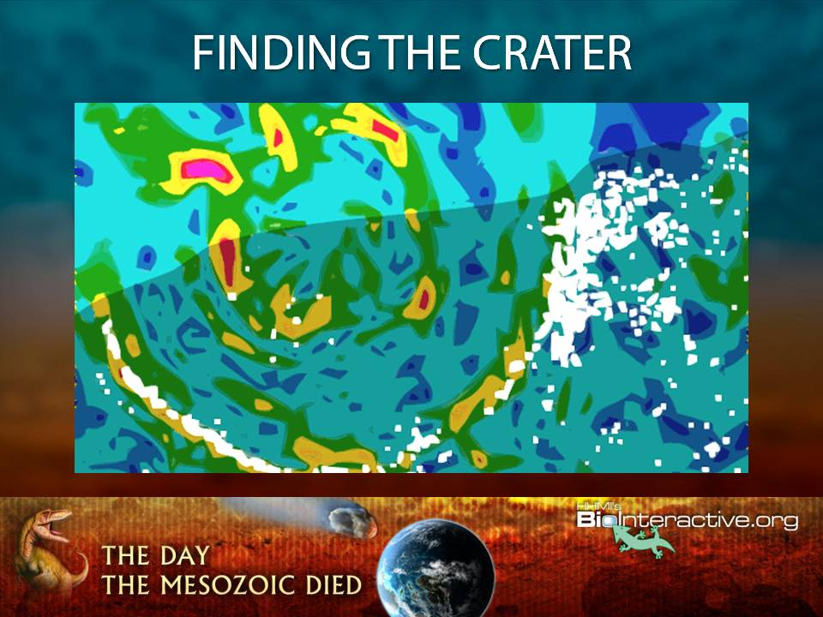

Slide 12
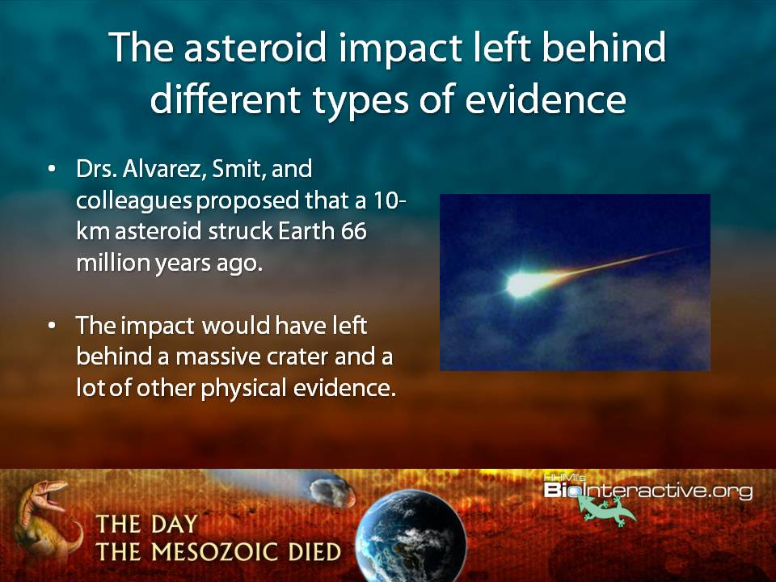

Slide 13
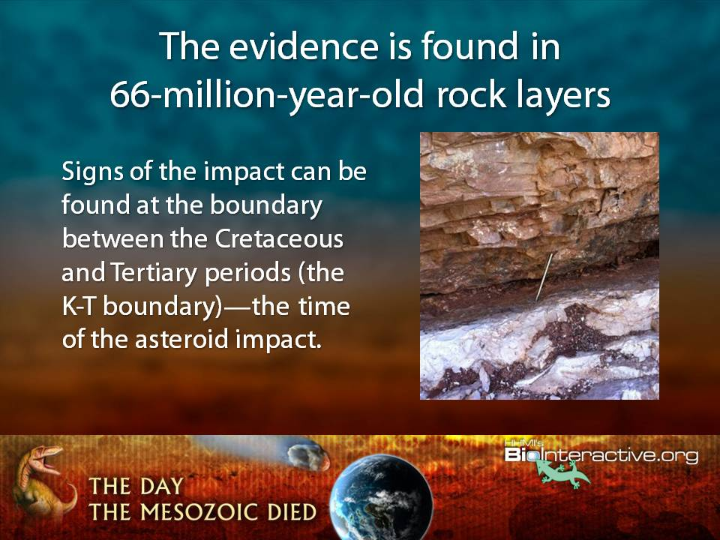

Slide 14
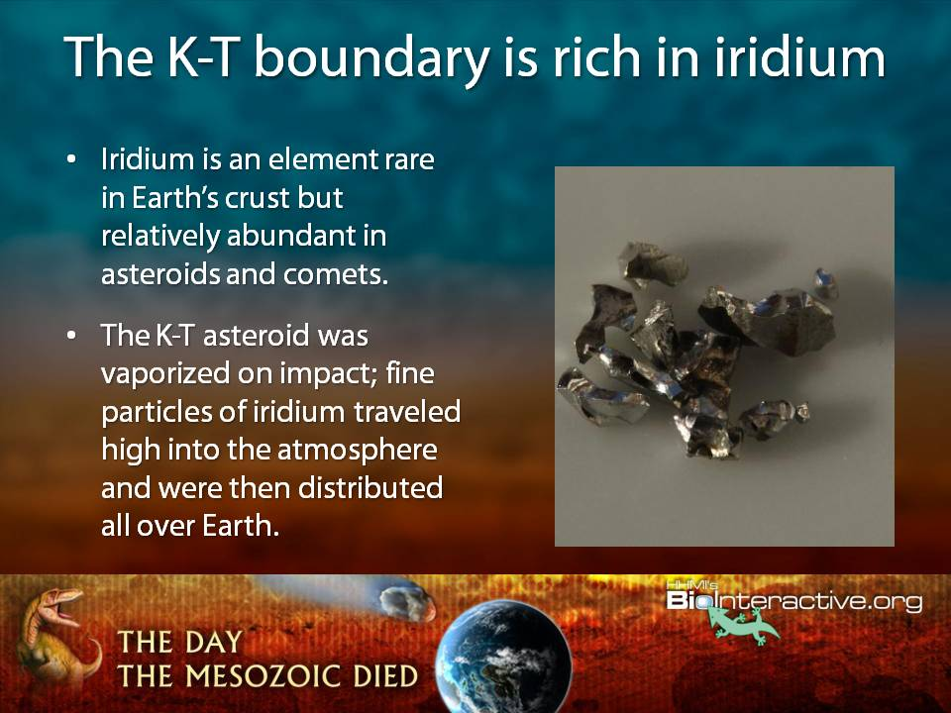

Slide 15
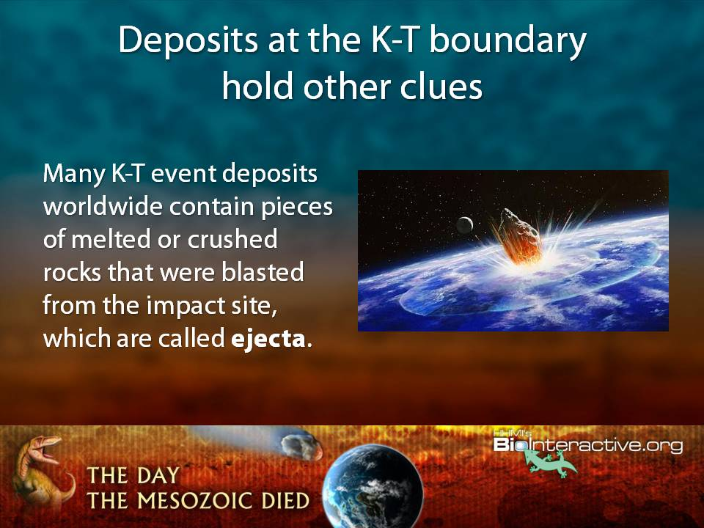

Slide 16
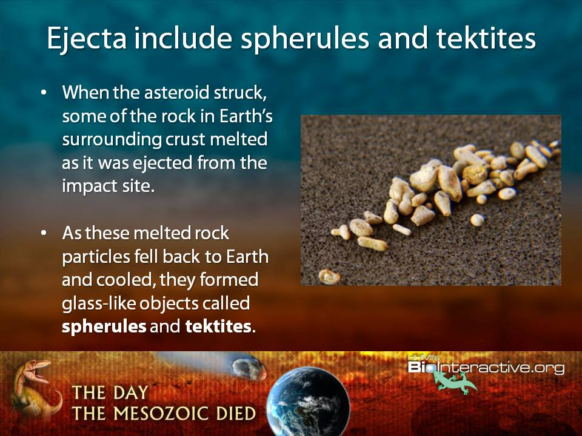

Slide 17
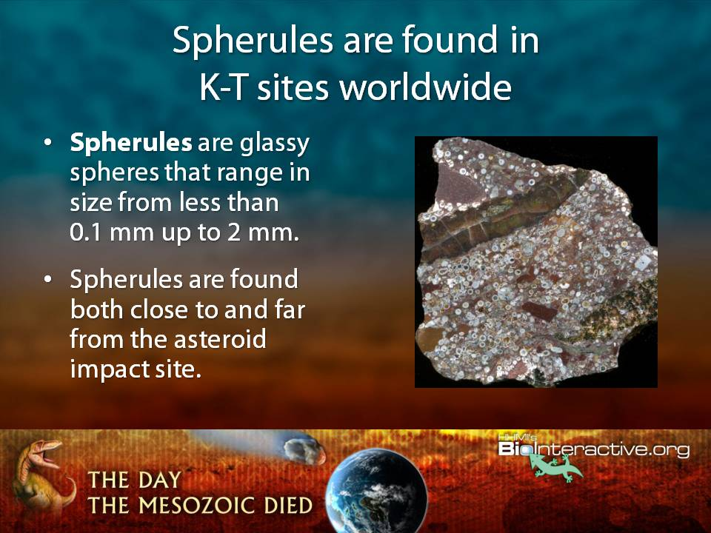

Slide 18
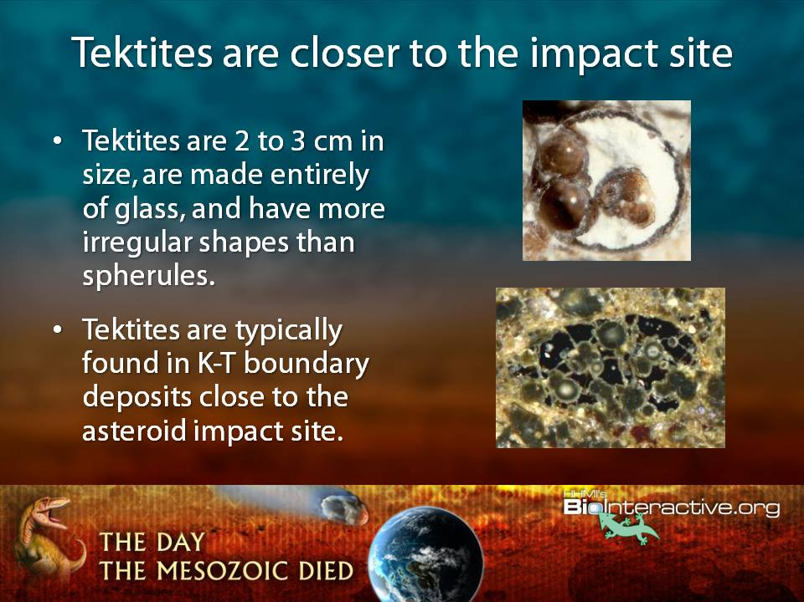

Slide 19
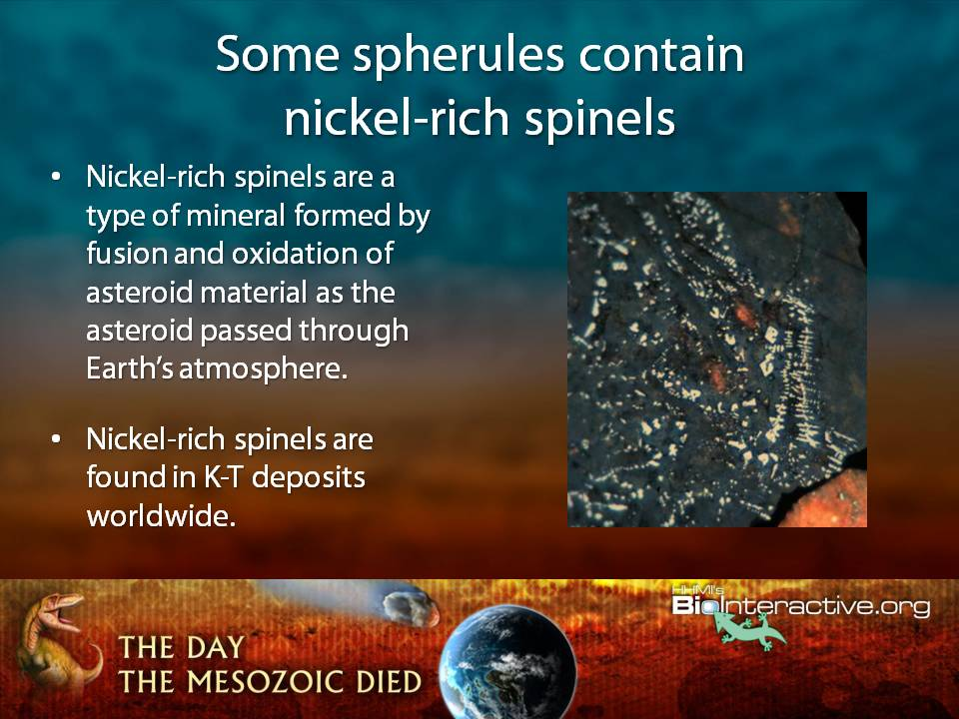

Slide 20
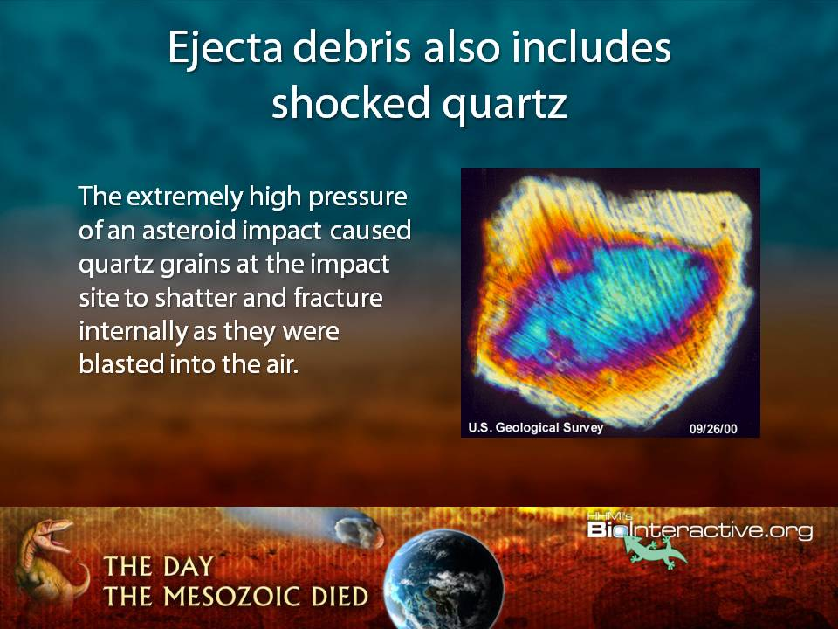

Slide 21
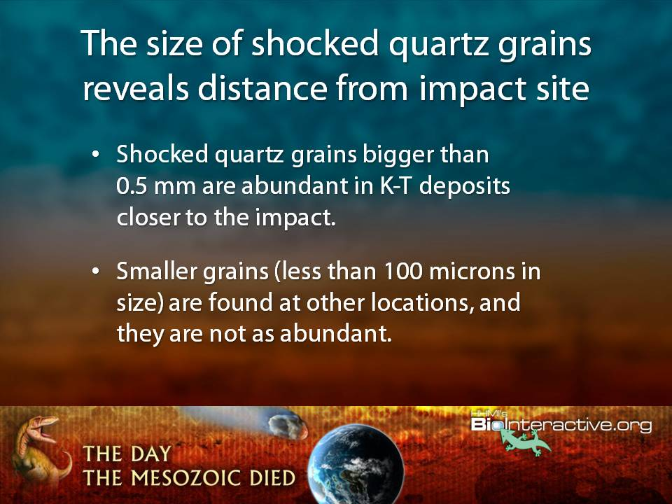

Slide 22
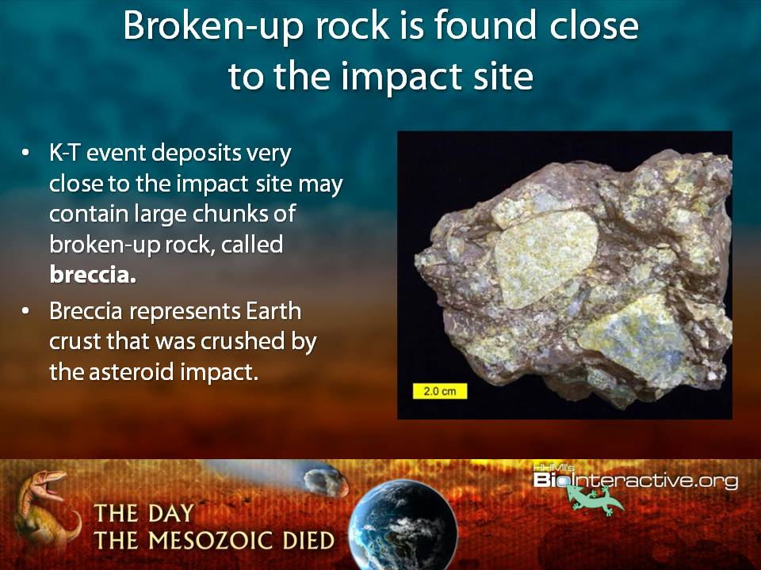

Slide 23
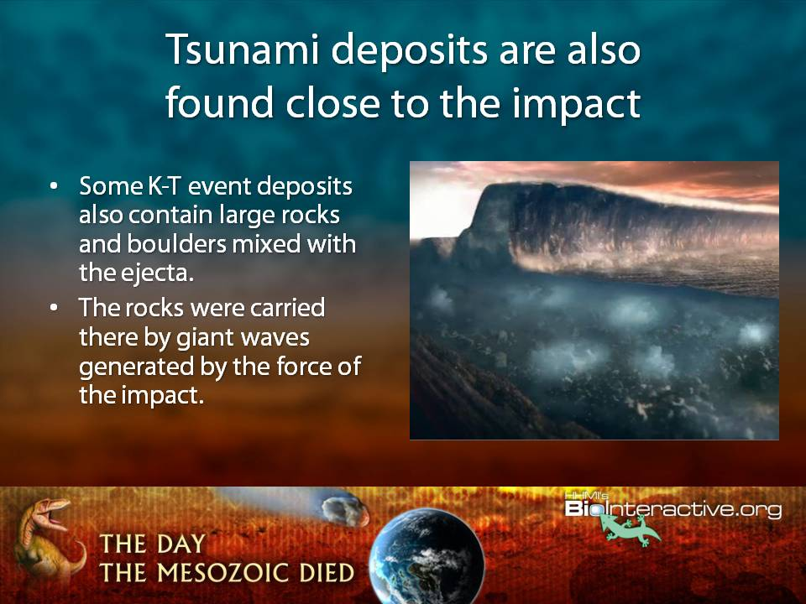

Slide 24
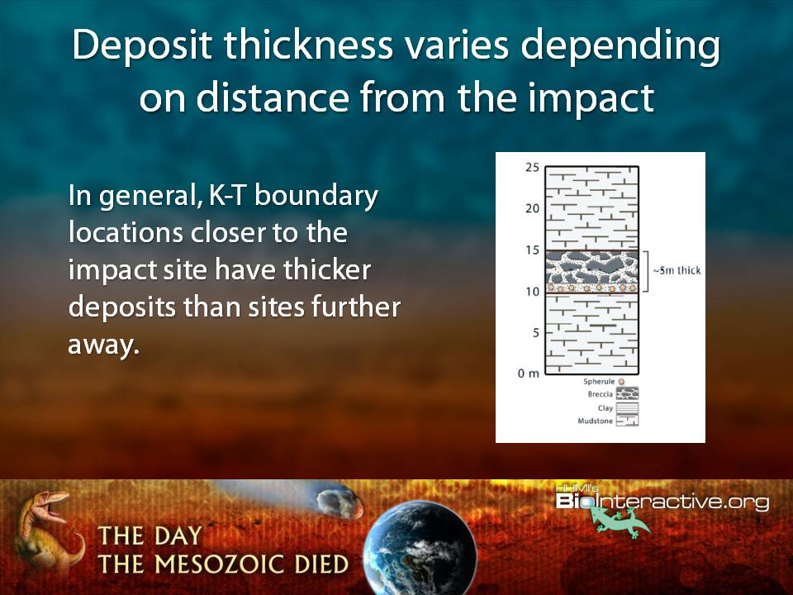

Slide 25
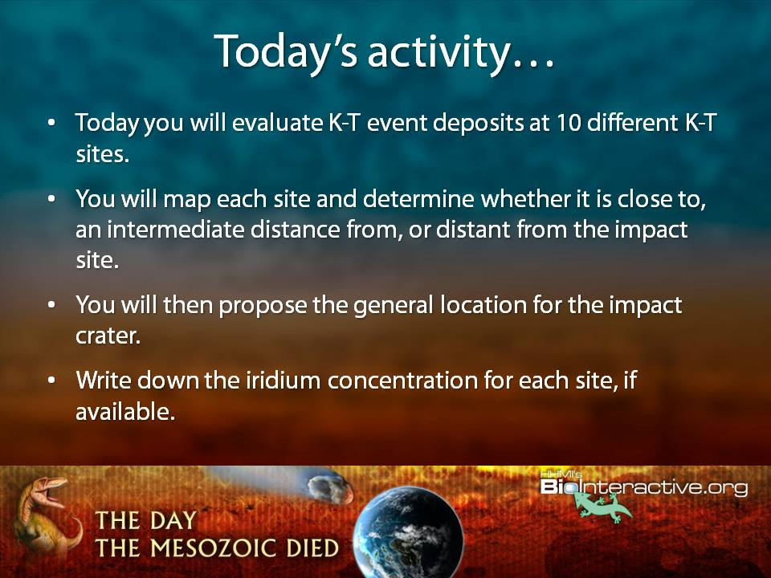

Slide 26
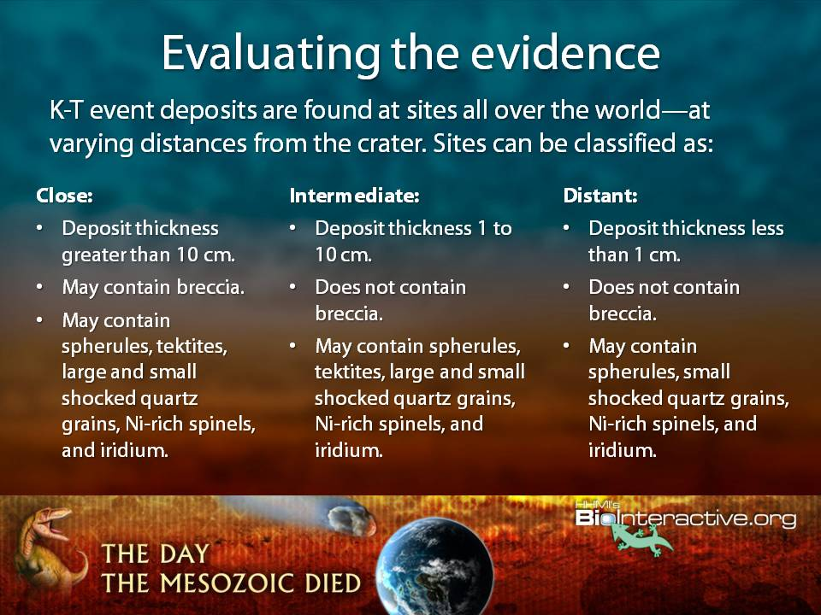

Slide 27
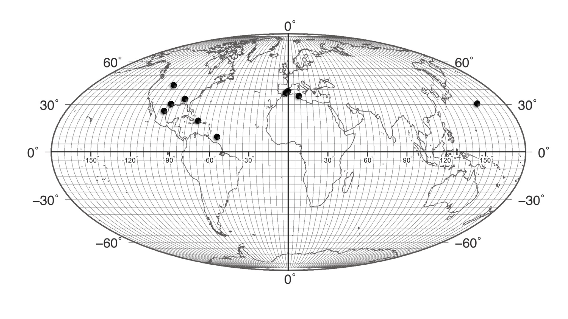

Slide 28
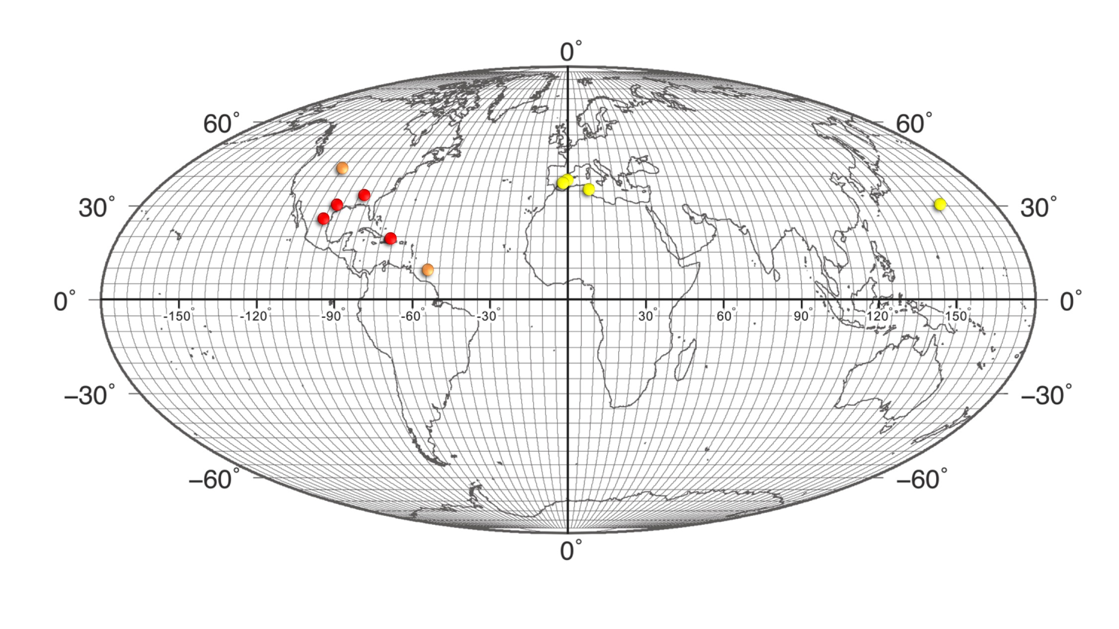

Slide 29
Tying it all together:
EarthViewer – Earth history at your fingertips
http://www.hhmi.org/biointeractive/earthviewer

Slide 30
EarthViewer
Interactive and data-rich
Visualize deep time & dynamic Earth
Connect Earth and Life Sciences
Explore what makes Earth habitable

Slide 31
EarthViewer Tour

Slide 32
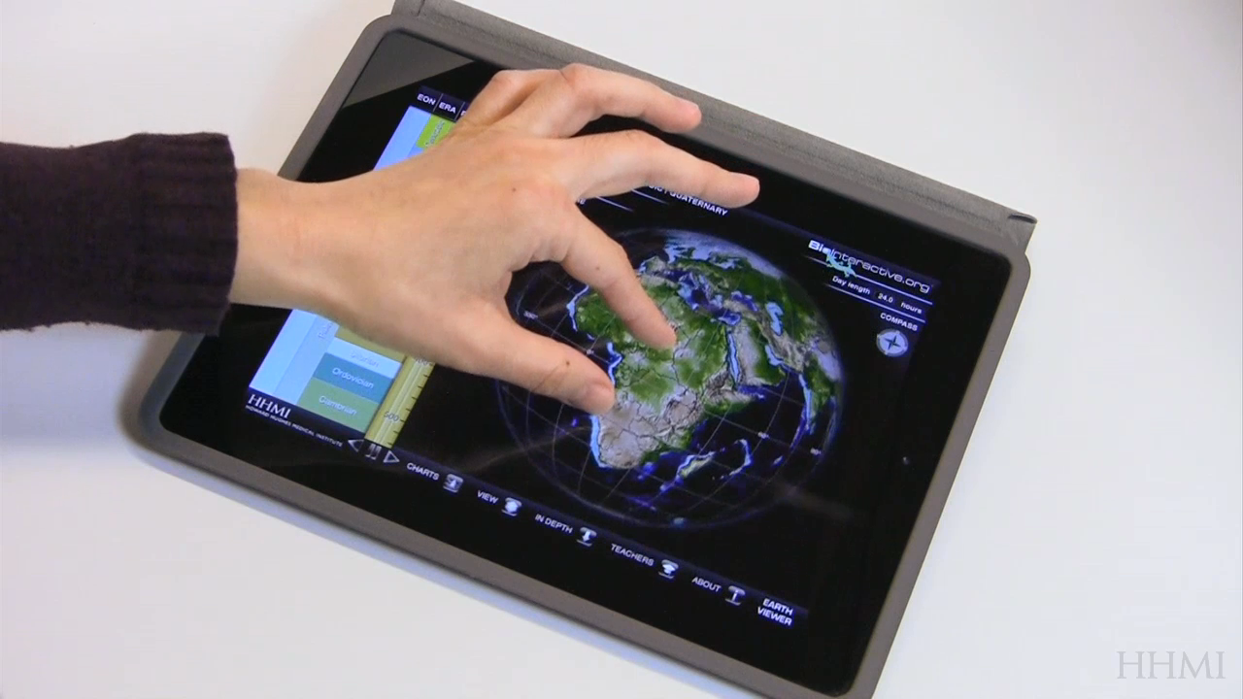
Navigate The World

Slide 33
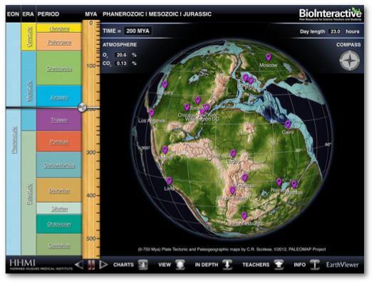
day length
years
atmospheric
composition
compass
menu

Slide 34
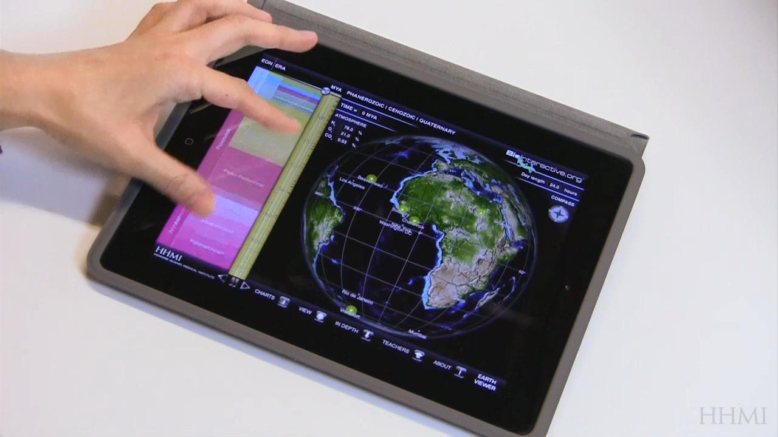
Three distinct time periods

Slide 35
Deep Time
(4.5 billion years)

Slide 36
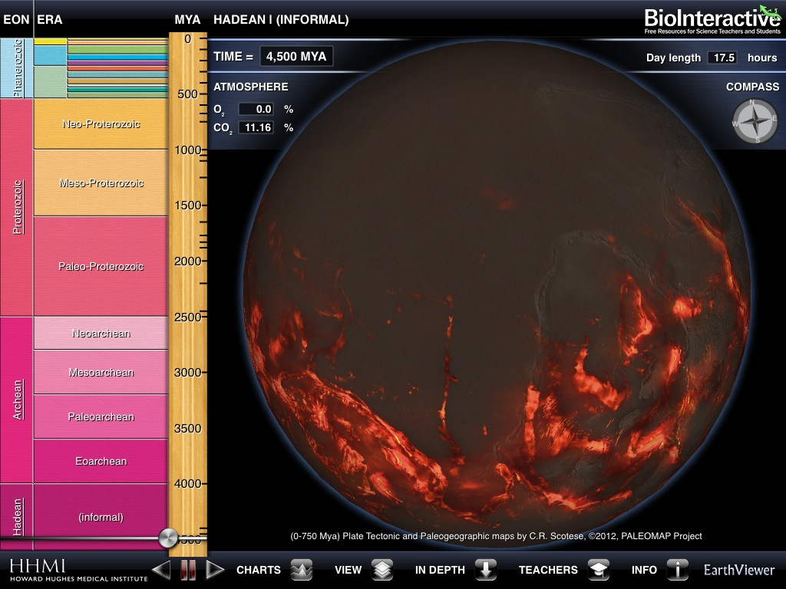

Slide 37
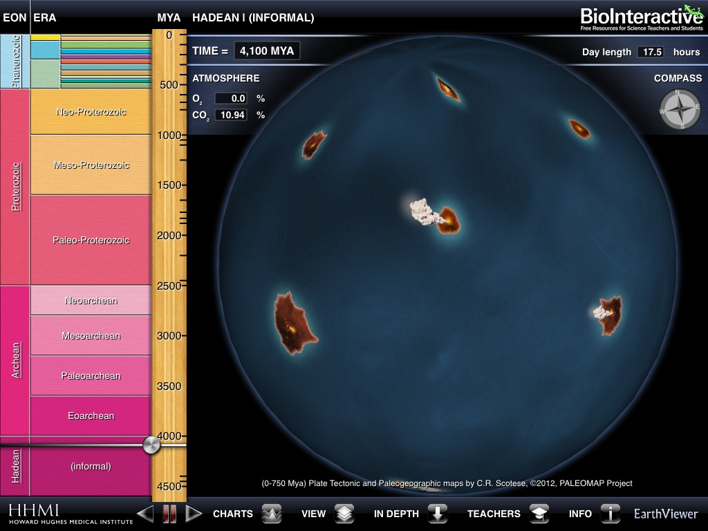

Slide 38
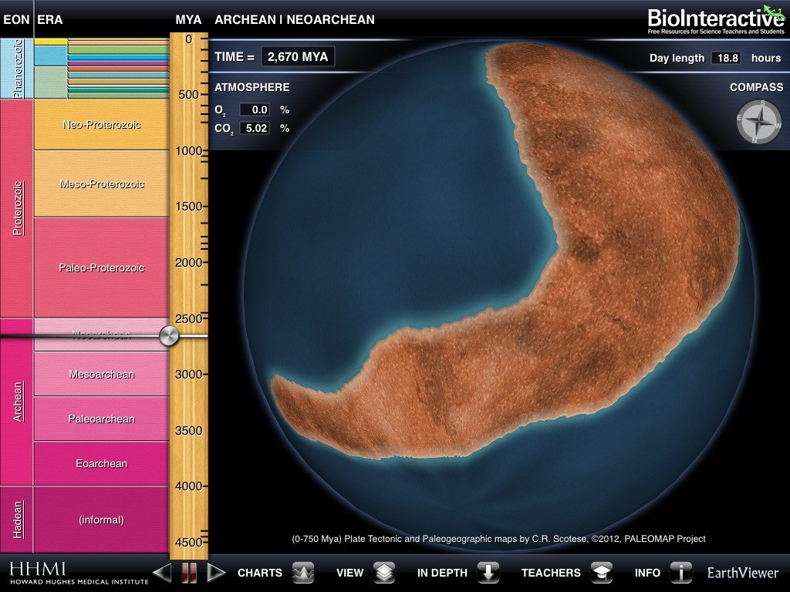

Slide 39
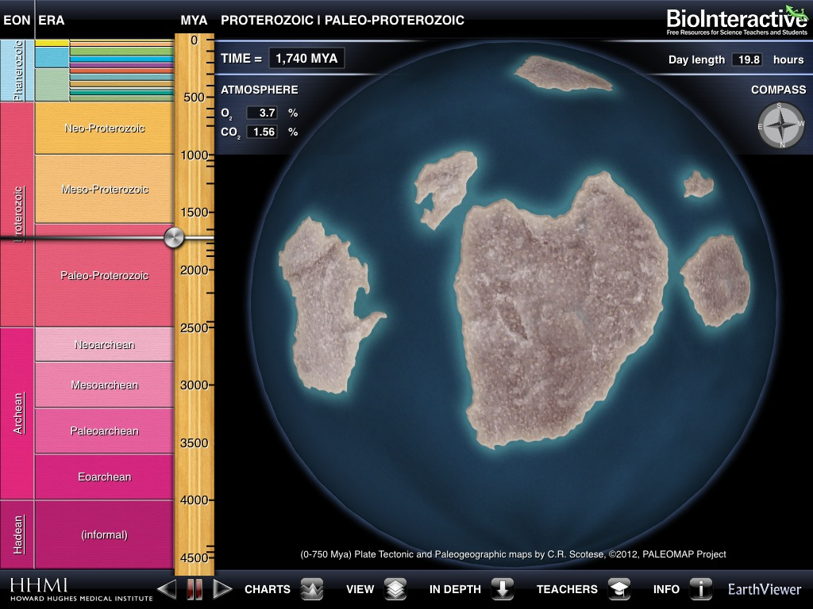

Slide 40
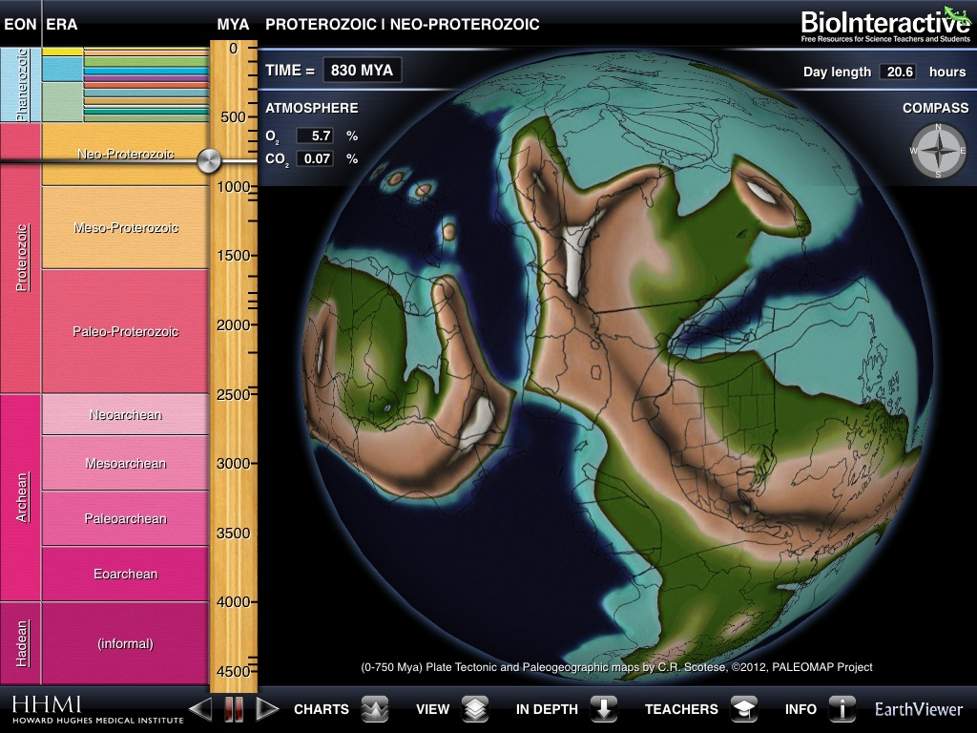

Slide 41
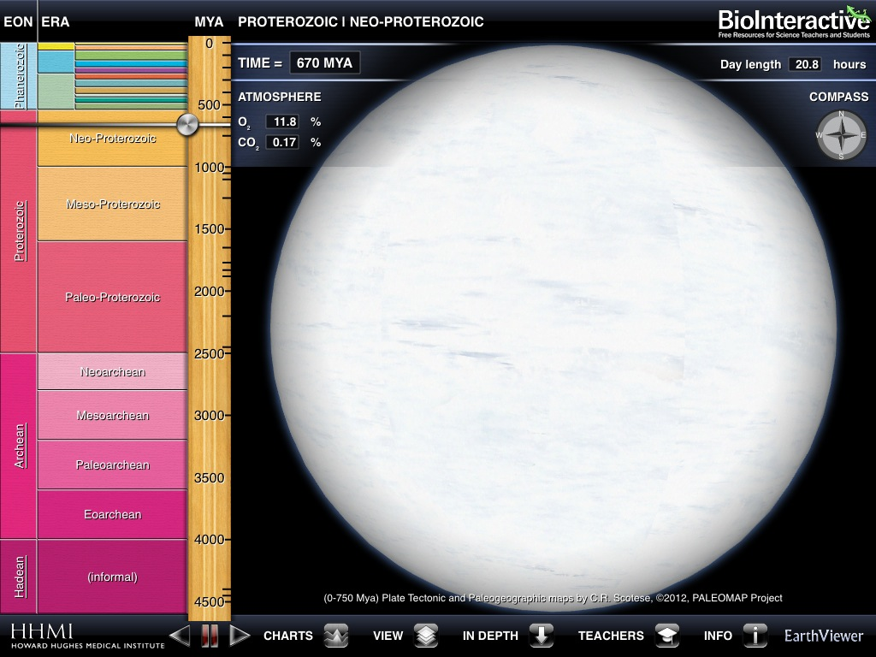

Slide 42
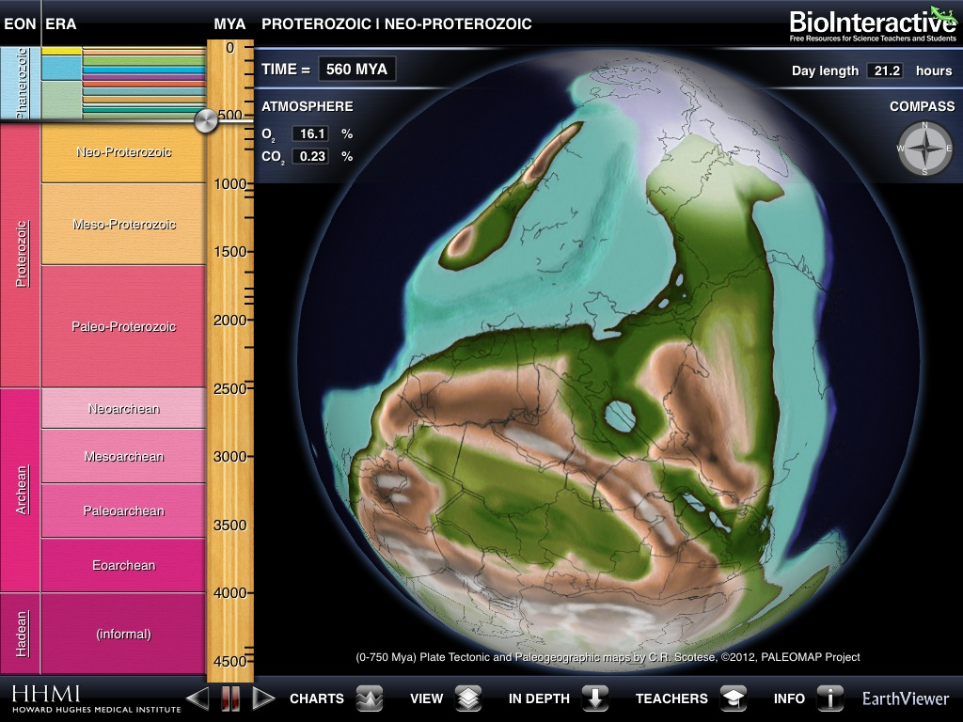

Slide 43
Phanerozoic
(500 million years)

Slide 44
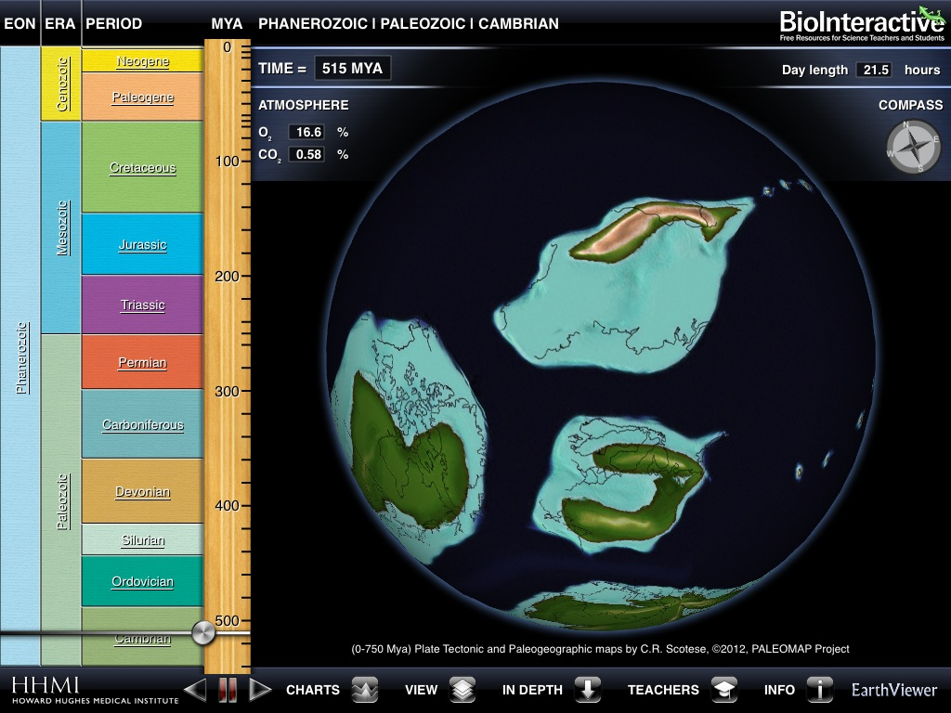

Slide 45
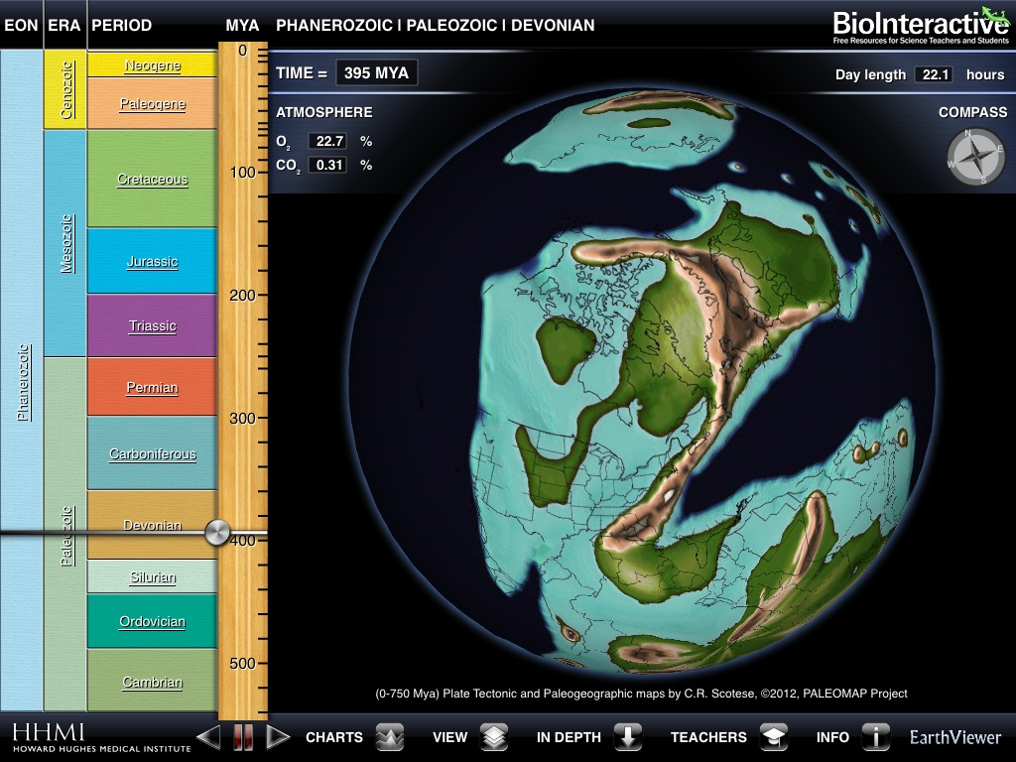

Slide 46
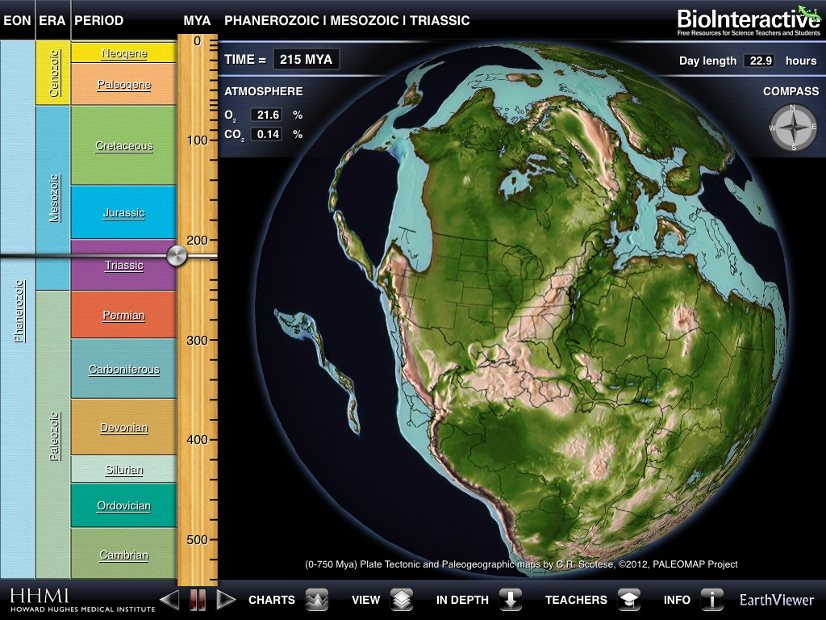

Slide 47
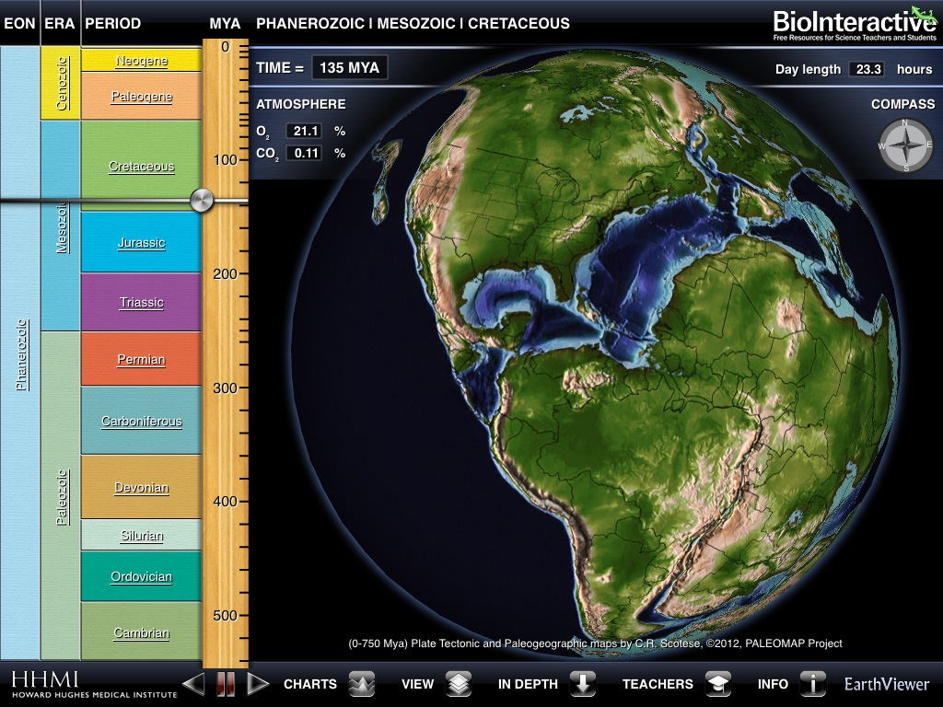

Slide 48
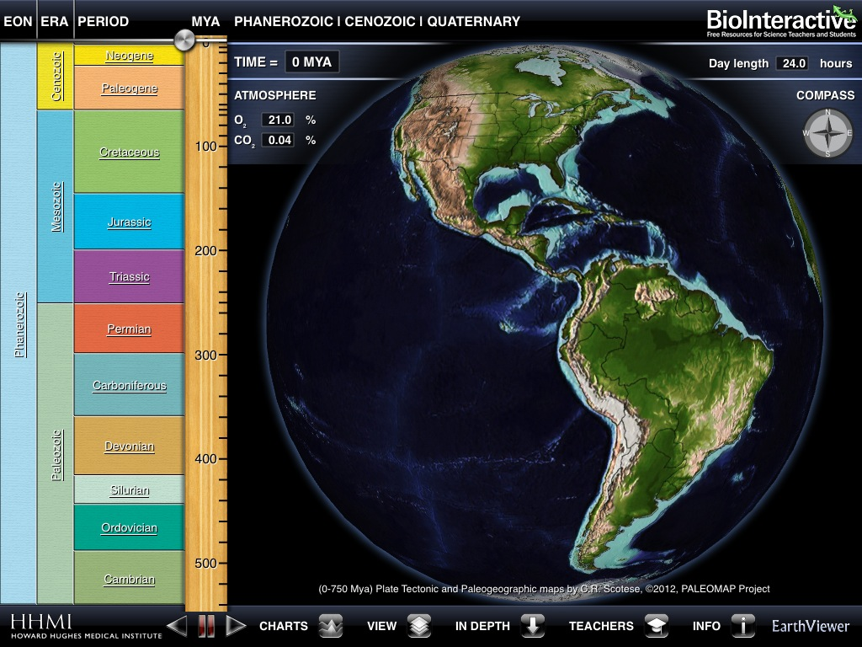

Slide 49
Modern Time
(100 years)

Slide 50
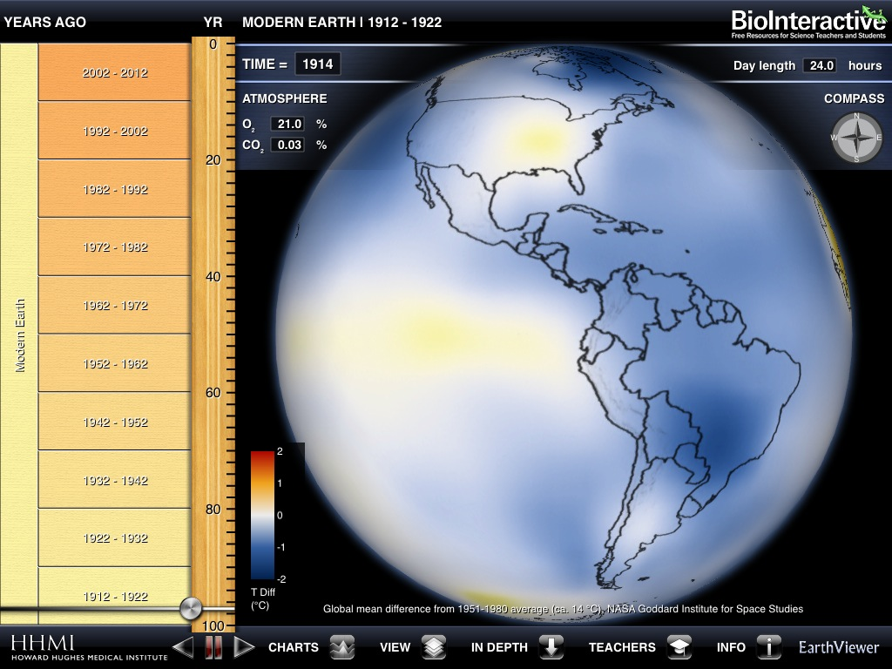

Slide 51
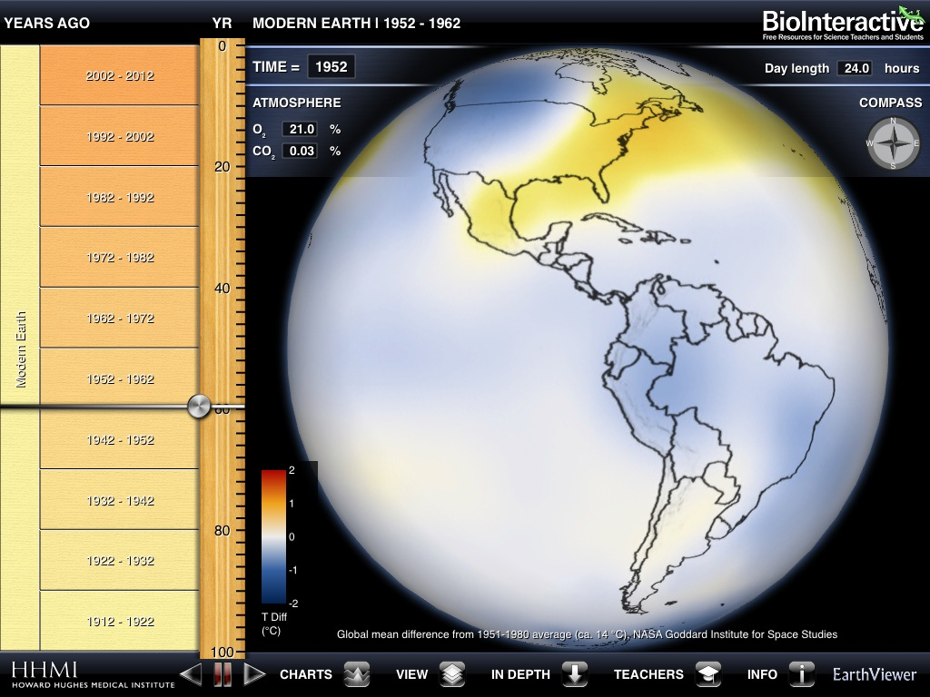

Slide 52
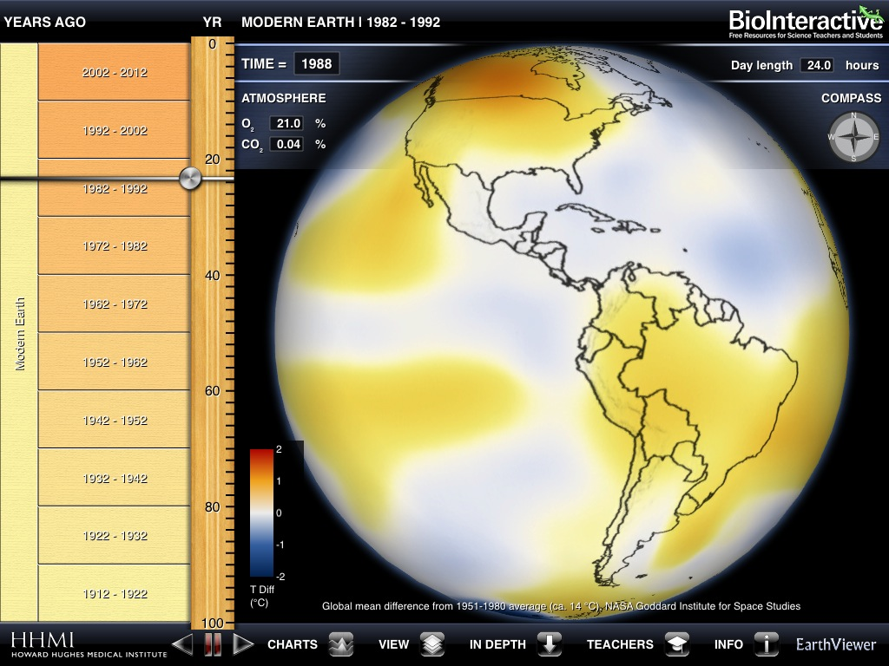

Slide 53
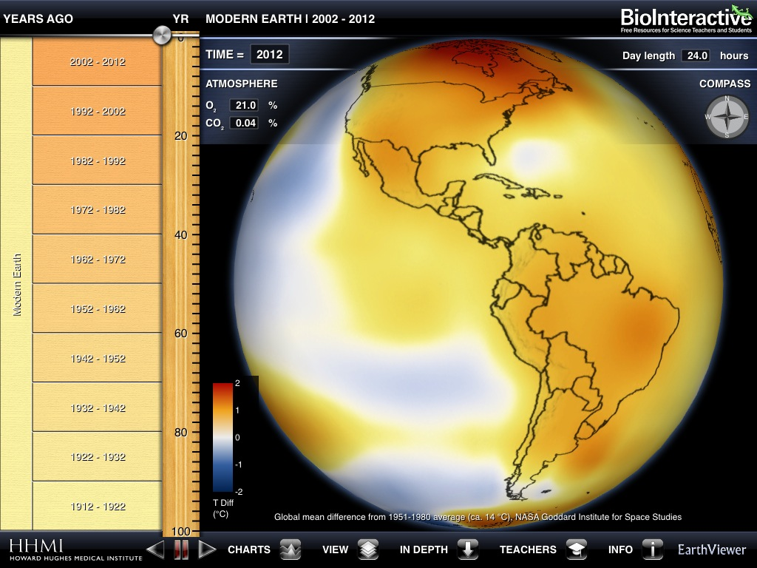

Slide 54
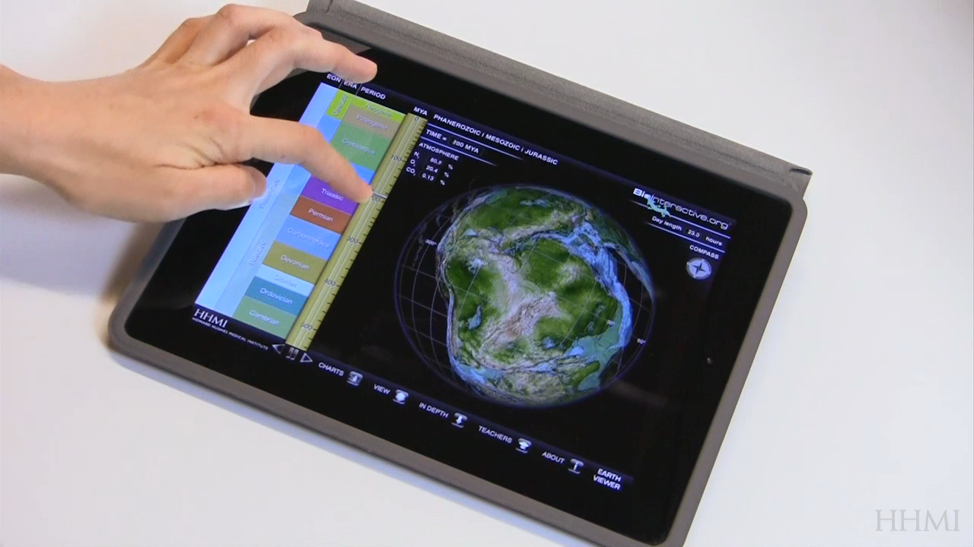
Continental Reconstructions

Slide 55


Slide 56


Slide 57


Slide 58


Slide 59


Slide 60


Slide 66

Explore the data

Slide 67
Exploring the
Faint Young Sun Hypothesis

Slide 68


Slide 69


Slide 70


Slide 71

Mass Extinctions

Slide 72

Additional Data Layers

Slide 73


Slide 74


Slide 75


Slide 76


Slide 77


Slide 78


Slide 79


Slide 80


Slide 81

In Depth Content

Slide 82


Slide 83


Slide 84
Give it a try!

Slide 85


Worksheet link:
http://www.hhmi.org/biointeractive/earthviewer-climate-guide-activity

Slide 86

0 - 45 MA
270 - 345 MA
435 - 455 MA
11.9 - 15.2 °C
totally covered in ice/snow
Snowball Earth
runaway ice albedo feedback
greenhouse effect

Slide 87


temperature anomalies
14 °C
~1 °C
has increased with temperature
has remained constant
has remained constant
has decreased as temperature increased
~70 years

Slide 88
EarthViewer in the Classroom

Slide 89
A Tool for Educators - Content
Earth Science
  Major geological events
  Voyage through time
  Fossils
  Impact Events
  Climate change
  Data analysis
  Atmospheric chemistry
Life Science Connections
  Habitable Earth
  Mass extinctions
  Biodiversity
  Climate change
Data Available: www.hhmi.org/biointeractive/earthviewer-data-files

Slide 90
A Tool for Educators - implementation
Single Tablet
  Visualizations to accompany lecture (screenshots!)
Multiple Tablets
  Guided inquiry (scavenger hunt)
  Exploration to generate hypotheses
A reference for students

Slide 91
Possible Inquiry Topics
Track your city through the last 100 years
Compare mass extinctions
Identify possible causes of mass extinctions
Connections between atmospheric chemistry and biodiversity
Describe a geologic time period
Tell the story of your favorite mountain range
What was Earth like when your favorite fossil lived
???

Slide 92
Sample Class – a few tablets
Break into groups with 1 tablet per group
Assign each group a different mass extinction
Ask students
  Was Earth’s climate like?
  What important biological events?
Make list of hypotheses
  Show luminosity
  Show CO2

Slide 93
Sample Class – single tablet
Show ancient Earth
Show temperature record
Ask students
  Was Earth warmer or cooler 3000 years ago?
  Why?
Make list of hypotheses
  Show luminosity
  Show CO2

Slide 94

www.facebook.com/biointeractive
Subscribe to the Newsletter:
http://bit.ly/BINews
Questions:
Mark Nielsen - nielsenm@hhmi.org
Heather Olins - holins@oeb.harvard.edu

